Slide 1
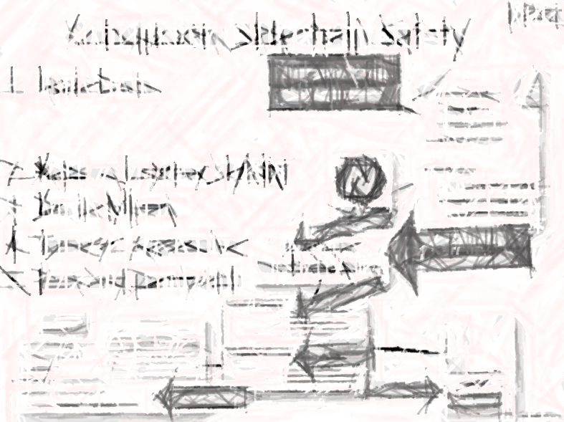
Sidechain Risks – The Case Against Worrying
Paul Sztorc
Sept 2nd, 2016
Notes:
We’ll all learn a lot about Bitcoin & Bitcoin Scalability in the process.

Slide 2
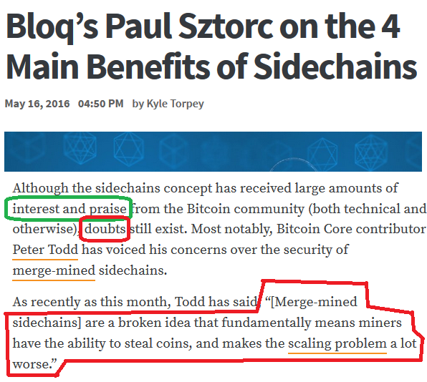
Concerns

Slide 3
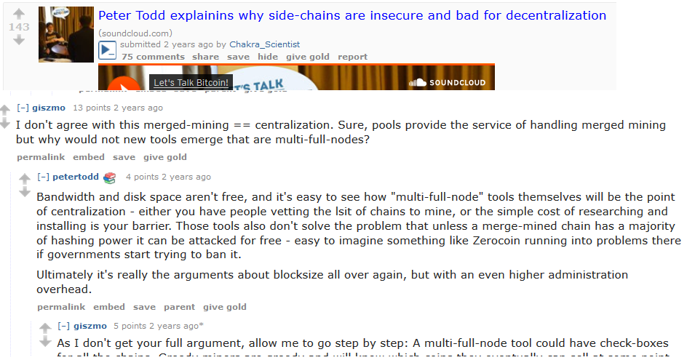
Concerns

Slide 4

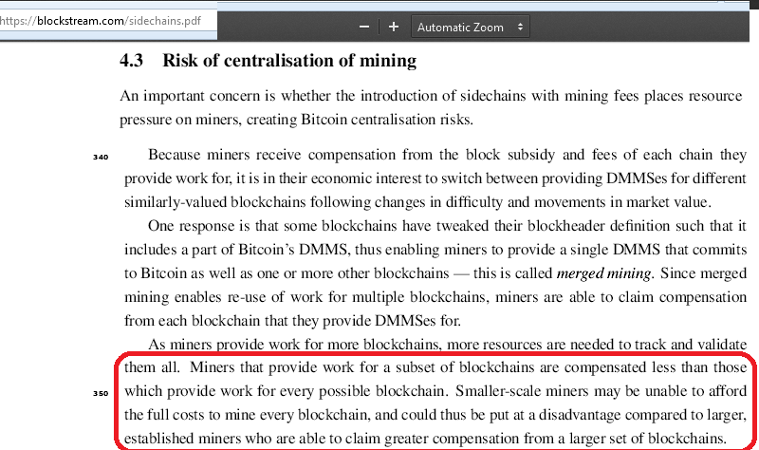

Problem?

Slide 5
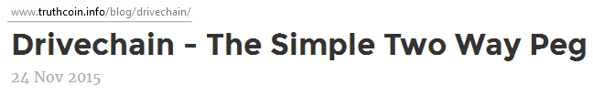
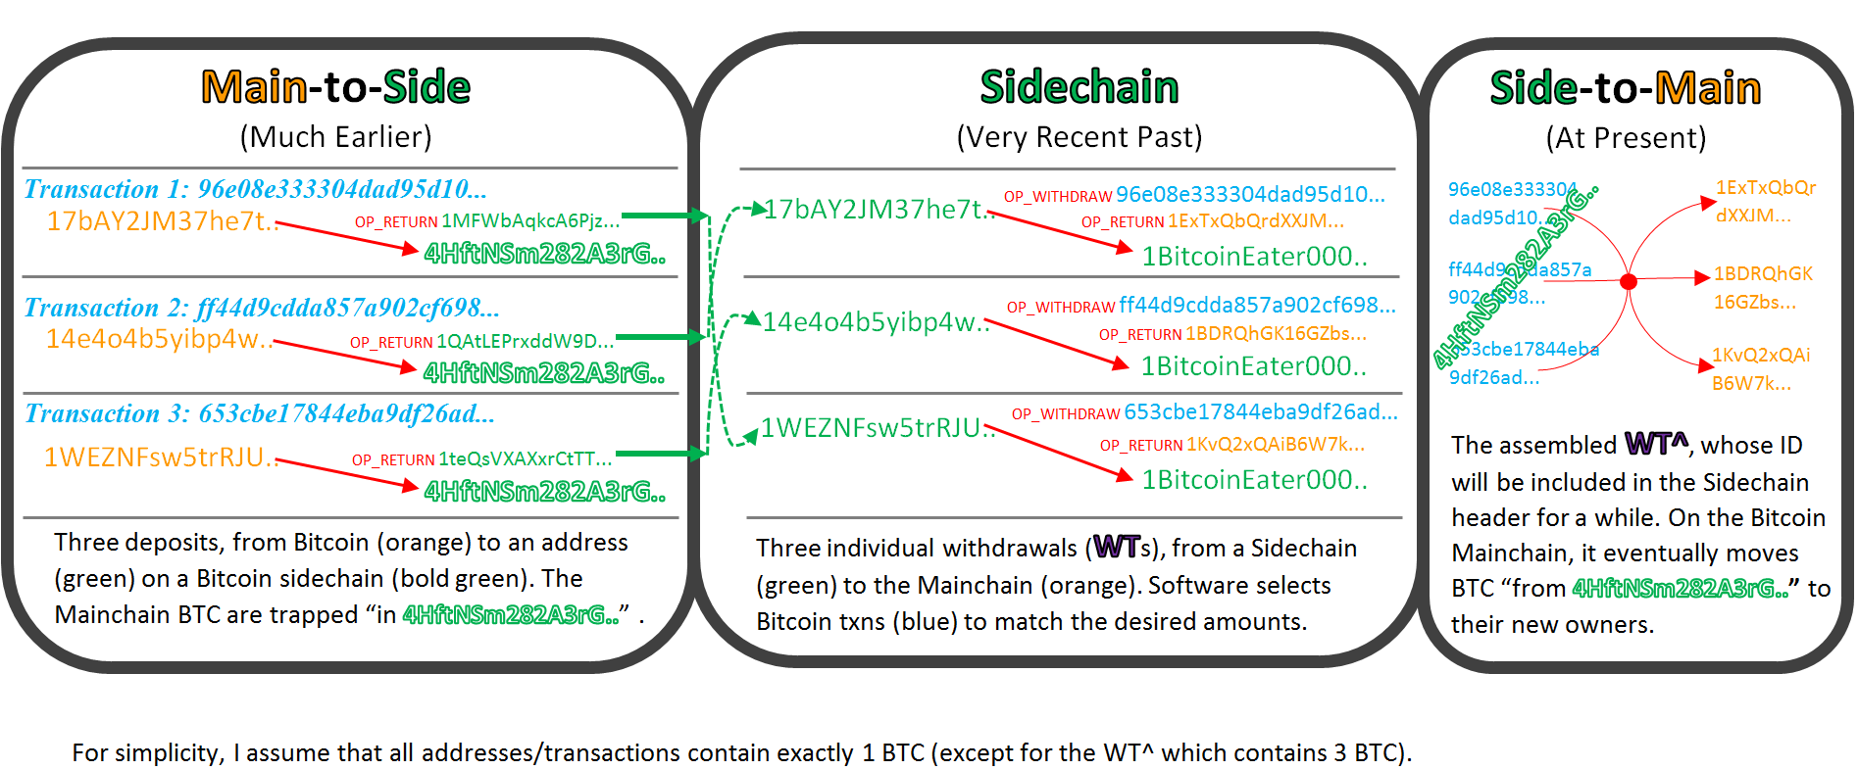
What is Drivechain?
M
S
S
S
S
Contracts, Payments, Services

Slide 6
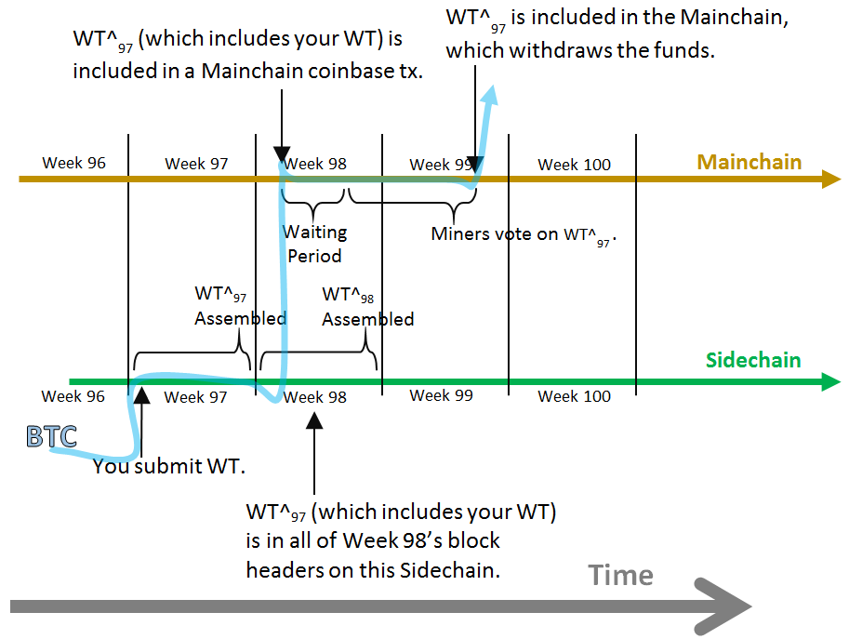
What is Drivechain?
04B4697D5319B8B0E461BE624EAD61331CA613216F061D2533490ABBB71616A0
M
S
S
S
S
Contracts, Payments, Services
Notes:
The combined WT^ --created behind the scenes by software– might look like this. This is eventually included in a Bitcoin block. There’s a waiting period, so that everyone can make sure everything’s kosher, here, then the miners “vote” on this transaction with their Hashpower.
If they accumulate enough work, this transaction here, defined by this, is allowed to go through.
So this (top row) is all the Bitcoin stuff.

Slide 7
Presentation Overview
Imagine a user who hates the idea of sidechains.
[a] To what extent can Bitcoin sidechains affect the Bitcoin Mainchain? (Limited to Mining)
[b] To what extent might the Mining Network be affected, by sidechains? (Data Transmission Capacity ‘Bandwidth’, Transaction Fees)
Interlude: The Docile Miner
Discuss Bandwidth in Detail (Propagation)
Discuss Fees in Detail (Competition, Calculus)
Light Commentary on Orphaning, & Conclusion
Notes:
Node costs and effects are almost completely firewalled.
…
Share my opinions of Bitcoin mining. Which are that miners, in general, have no motivation, nor any real ability, to harm Bitcoin users. And I’m even going to argue that they technically don’t “make” any decisions, and they don’t “cause” anything to happen. They are acted upon, but they have no agency themselves. They’re a shadow or a reflection of the value created by each block.

Slide 8
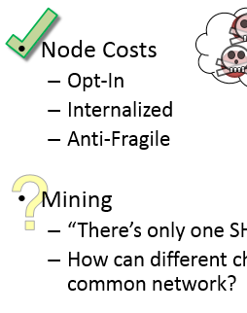

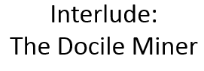
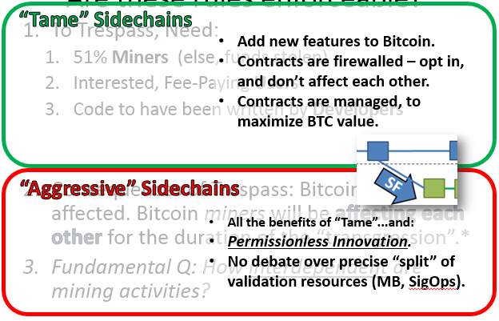
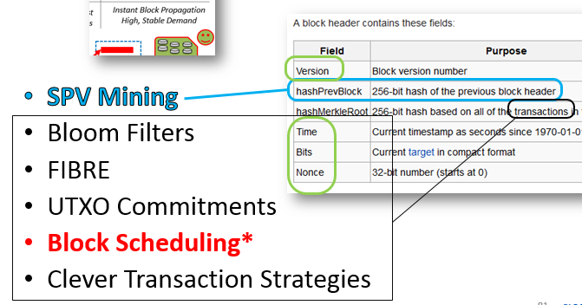
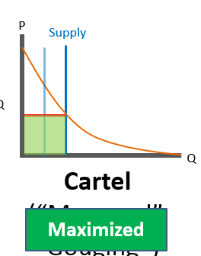
Conclusions -- Preview
Just don’t run the software.
Node Costs
Relative to other SF/MM
Docile Miners
Tame vs. Aggressive
Fees and Bandwidth
No one cares!
My Mining Experience?
I’m still worried
Stop stealing my space!
Bandwidth
Fees
Notes:
No different from someone choosing between Google Chrome and Mozilla Firefox.
How will your sidechains affect my mining experience?

Slide 9
Part 1 – Blockchain Interactivity
How do sidechains affect Bitcoin?
How do we reduce / eliminate this?
Notes:
Goal is that, someone running Bitcoin Core would not need to notice or worry about or think about any sidechains, unless they want to.

Slide 10
Agenda
The Problem (11)
One General Solution (3)
Is this GS Robust? (5)
Beyond The Limits (5)

Slide 11
The Problem
More Stuff = More Resources
Node Costs
Opt-In
Internalized
Anti-Fragile
Mining
“There’s only one SHA256²( ) network.”
How can different chains affect each other, through the common network?
Monero
Bitcoin
M
M
M
?
Namecoin
Notes:
The more stuff we put on a blockchain network, the more resources the blockchain will necessarily consume.
Now I’ll divide this analysis into node costs and mining. Because there are two key differences: [1st] miners get tx fees, but nodes don’t, [2nd] for microeconomic, I expect all sidechains to be merge-mined, which means that the same group of miners will mine all sidechains.
Node costs (storage, tx-validation/CPU, marginal bandwidth ( ie bandwidth per block ), etc) – these are all “opt in” and “internalized”. If you don’t to use the features of, for example, a Monero sidechain, you don’t have to run any Monero software, or download, or process, or store, or even be aware of any of those transactions.
If group agrees to pay these costs, to receive some benefits, that’s on them. And we wish them the best of luck. It’s up to the designers of each sidechain...whether it’s useful or not – very similar to every other piece of software you run on your computer. This is ideal. We’re talking a fully opt-in soft fork, to add each sidechain, and the user needs to opt in to additional node software.

Slide 12
Damaging the (BTC) Miners
How are Bitcoin blocks found?
Operating
Capital
Network
Power
Current Block (header)
Blockreward (tx fees, sub.)
Needs:
Hardware
Ideal:
arg min (Power_Costs) would be Geographically Distributed
Equal Access to Best Hardware/Practices
Instant Block Propagation
High, Stable Demand
Notes:
Miners make blocks. What could possibly go wrong with that process?
Let’s take a big look, so that we don’t miss anything.
To make anything: Capital, dump some ingredients in, out comes the result.
Reverse Obscurity
Namely, hardware but also expertise (“know how”), as well as software. Network costs as well, because you can’t mine a **new** block unless you have the **current**.
Current = latest valid block “valid” – defined as ‘meeting the rules’ of the Bitcoin protocol
“latest” – defined as ‘having already reached 51% of the network hashrate’
(That’s not a very precise definition, but it’s more precise than nothing.)
These are all modified by humans, of course. Humans can negotiate corrupt power deals, withhold hardware, or withhold blocks.
So, we have a way to go. Under these ideal conditions, it is hard for anyone to interfere with mining

Slide 13
What’s Changing?
Bitcoin
Bitcoin
M
M
M
M
M
M
Namecoin
(Sidechain)
Bitcoin
Bitcoin
Ignore for now.
{ Power, Network } 12.6 BTC
{Power, Network} 12.6 BTC
Namecoin
Free (merged-mining).
{Power , Network} 00.3 BTC

Slide 14
Define Value of Sidechain Option
α = E( New tx fees ) – E( New Node Costs )
Bitcoin (N/A)
{ Power, Node Costs } 12.6 BTC
α_{Namecoin}
= 0.296 BTC
{ Power , Node Costs } 00.3 BTC
α_{Zerocoin}
{ Power , Node Costs } 00.2 BTC
= 0.197 BTC
α_{Rootstock}
= 0.480 BTC
{ Power, Node Costs } 00.5 BTC

Slide 15

But is it really an “option”?
negative
The sidechain is unprofitable, and will be ignored.
α
positive
The sidechain is profitable...
...and must be mined.
Monero
(SC)
Bitcoin
Revenue
Costs
$
Difficulty
$
$
M
$
$
$
M
$
$
M
f( “What other miners do.” )
Namecoin
(SC)
α
f( )
Notes:
If the sidechain increases mining ROI, it’s equivalent to an improvement in hardware efficiency. Like a better ASIC design…because it’s the same power expenditure, but for a higher BTC revenue.
( In other words, hardware which *would* be unprofitable is instead profitable. So, instead of being off, it’s on, and there’s a higher network hashrate / higher equilibrium difficulty. )
As Don Corleone would say, “It’s an offer you can’t refuse”.

Slide 16
Sidechains: Not An Option

Slide 17
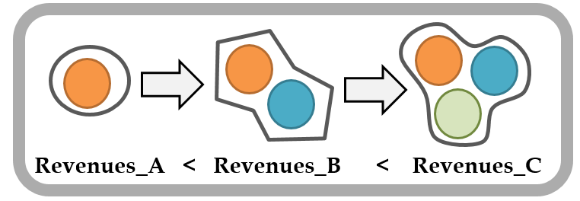
Miners Must Run All Viable Sidechains
Sidechains are affecting the Bitcoin miners.
What are the effects of this?
Can we minimize these effects?
What recourse do we have, if something bad happens?
Notes:
Interactions need to be considered, as a function of themselves and across time, and so forth.

Slide 18
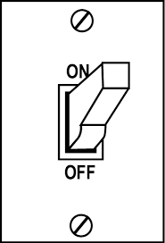
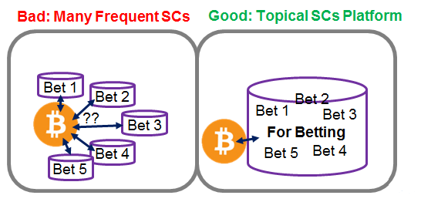
Recall: Drivechain Philosophy
(All) Sidechains
Soft fork to add each optional SC.
SCs are Rare, Topical, Profitable, Slow, Deliberate.
(Trivial) Protection: No SCs added, until market is okay with it.
Notes:
[1] “Miners” (51%) have to take deliberate action, to add each new sidechain to BTC, [2] they have to take continuous action, in the form of merge mining. Individual miners can stop MMing, at any time.
Since they’re opt-in, and opt-out, we have some automatic safety if things go wrong. [next]
So, let’s imagine the dreaded scenario: Some miners decide to be evil, and they group up, to make 51%, and they add an “evil sidechain”, and they do this purely to attack smaller miners. For example, let’s say they mine something called Evil YouTube Chain, which has absurd node costs, which far outweigh tx fees. Because there really wasn’t wrong with regular Youtube, which is Free. Ok, so what? Smaller miners just don’t run this chain. Node costs *don’t* outweigh the fees, so they aren’t at any disadvantage.

Slide 19
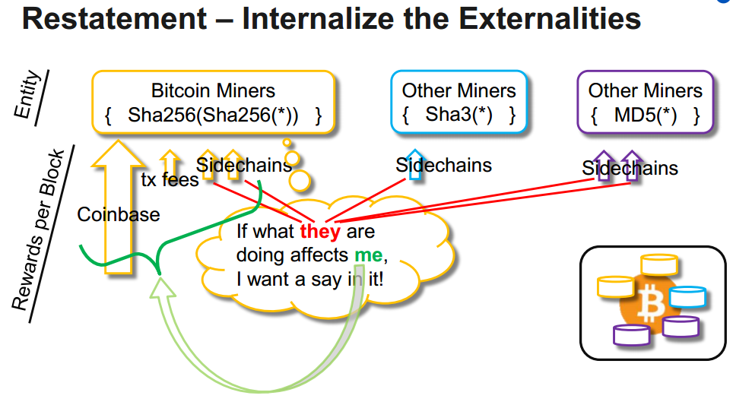
Interactivity (Previous presentation.)
Notes:
This is also from the pervious presentation.
There, I describe how I’ve “flipped the work”. Even for rival chains that might use a different proof of work, within the sidechain –which again I don’t expect to happen at all-, … their activites may affect Bitcoin, and Bitcoin’s value. Therefore, I require – in the OP CODE I designed for Drivechain – Bitcoin miners, ie Mainchain miners, to sign off on these sidechains.
For full details, watch that presentation.

Slide 20

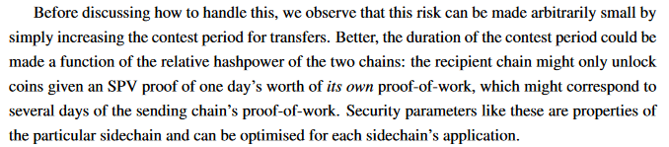
Solves Many Problems
Nodes “just validate”.
Miners “just mine”.
Drop sidechains they don’t like.
That have burdensome node-requirements.
That threaten privacy or fungibility.
Keep sidechains they like.
Precedent
Merged Mining
+ Implications of 21 L for MM.
+ Impl. of MM on relative HP.
+ Exploit. of LN / AS, a-SC for Sec.
Notes:
For example, the YouTube Chain.
Giant list of ingredients, no recipe.
MM problems: difficulty-adjustment problems – stalling due to confidence crisis. The mere fear of this happening, or of possible fear –at any time in the future-, might prevent the sidechain from working at any present time.
There is some room for optimism – Namecoin has been merged mined with Bitcoin for the last 5 years. It has about 51% of the hashrate of Bitcoin. From the point of view of miner’s costs, there is no difference between Drivechain’s merge-mined sidechains and merge-mined Altcoins. And how many problems has Namecoin caused you, Bitcoin user, in the last 5 years? I can’t think of any.
Most people don’t even realize what’s happening. Which is the point.
Nonetheless, I’m going to continue to try to identify the dangers and walk through them. Namecoin is pretty obscure and unpopular, so I’m not sure how well it generalizes.

Slide 21
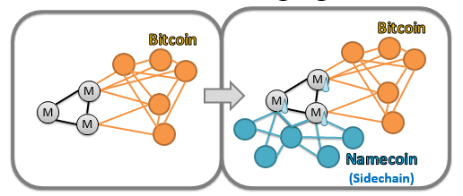
Sidechain Interactivity
What we’re talking about.
Bitcoin Core, being *affected* by a sidechain.

Slide 22

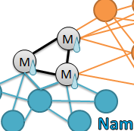
General Solution
Rules for All SCs
Rules for Bitcoin
Total Blocks = 1 MB
Total SIGOPS = 20,000
Blocks = 1 MB
SIGOPS = 20,000
...
Blocks = 0.9 MB
SIGOPS = 18,000
...
Blocks = 0.1 MB
SIGOPS = 2,000
...
This does NOT ends the compulsion for miners to “run all profitable sidechains”.
But it DOES, necessarily, limit the total burden to exactly what it was before (ie, pre-sidechain).
Notes:
Onto the main event.
General solution. – Worst Case, assume that there is horrible interactivity.
I’m not advocating for it – just showing that it does exist.

Slide 23
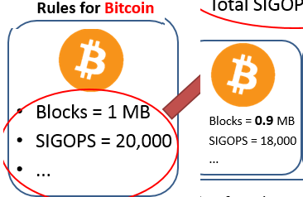
Bad News: Bitcoin Affected
We’ll fix this later.
Notes:
And, the bad news is that, Bitcoin isn’t affected indirectly, by the sidechain, it’s affected directly, instead.
This would still be a way of using the Drivechain idea, for sidechains, to add new features to Bitcoin. Soft fork only. Totally firewalled.

Slide 24
General Solution
Rules for All SCs
Rules for Bitcoin
Total Blocks = 1 MB
Total SIGOPS = 20,000
Blocks = 1 MB
SIGOPS = 20,000
...
Blocks = 0.9 MB
SIGOPS = 18,000
...
Blocks = 0.1 MB
SIGOPS = 2,000
...
Rules enforced by soft fork(s) & “soft fork”-like agreements.
This does NOT ends the compulsion for miners to “run all profitable sidechains”.
But it DOES, necessarily, limit the shared burden to what it was before (pre-sidechain).
If users/miners try to add a sidechain in violation of this policy, then: (miners should) steal the sidechain’s BTC - deposits.
Hence, incentive to maintain policy. ( +Incentive for miner to pretend to violate policy, then backstab. )
Notes:
I’m not advocating for it – just showing that it does exist. By that I mean, if >50% of miners agree to follow these guidelines, they are fully enforced. To break this, need [1] a miner majority, [2] you need users (to pay tx fees), and you need [3] trust from users, and of course you need [4] developers to write the code.

Slide 25
General Solution
Rules for All SCs
Rules for Bitcoin
Total Blocks = 1 MB
Total SIGOPS = 20,000
Users
Join Chain
(Deposit BTC)
Miners
Join Revolt
No Thanks
Honor Agreement
(Steal)
Blocks = 1 MB
SIGOPS = 20,000
...
To break agreement, Users must trust Miners.
Blocks = 0.9 MB
SIGOPS = 18,000
...
Blocks = 0.1 MB
SIGOPS = 2,000
...
Rules enforced by soft fork(s) & “soft fork”-like agreements.
This does NOT ends the compulsion for miners to “run all profitable sidechains”.
But it DOES, necessarily, limit the shared burden to what it was before (pre-sidechain).
If users/miners try to add a sidechain in violation of this policy, then: (miners should) steal the sidechain’s BTC - deposits.
Hence, incentive to maintain policy. ( +Incentive for miner to pretend to violate policy, then backstab. )
Notes:
Because the users have to deposit to these “illicit sidechains”, hoping that miners won’t steal from them.

Slide 26
General Solution
Rules for All SCs
Rules for Bitcoin
Total Blocks = 1 MB
Total SIGOPS = 20,000
Users
Join Chain
(Deposit BTC)
Miners
Join Revolt
No Thanks
Honor Agreement
(Steal)
Blocks = 1 MB
SIGOPS = 20,000
...
To break agreement, Users must trust Miners.
Blocks = 0.9 MB
SIGOPS = 18,000
...
Blocks = 0.1 MB
SIGOPS = 2,000
...
Rules enforced by soft fork(s) & “soft fork”-like agreements.
This does NOT ends the compulsion for miners to “run all profitable sidechains”.
But it DOES, necessarily, limit the shared burden to what it was before (pre-sidechain).
If users/miners try to add a sidechain in violation of this policy, then: (miners should) steal the sidechain’s BTC - deposits.
Hence, incentive to maintain policy. ( +Incentive for miner to pretend to violate policy, then backstab. )
Notes:
Then they just won’t join, and then they’ll be no transaction fees at all.

Slide 27
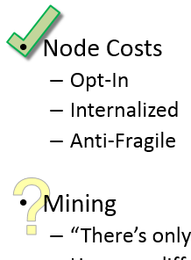
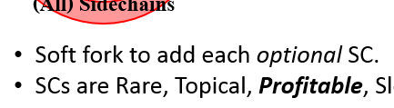
Evil Miners? (Vs Users) Remember: Users Always Have Option to Ignore New SCs
…
Main
HF
1 MB / Block
SF
Side 1
Side 2
0.2 MB / Block
SF
Notes:
“Say…we’re the evil miners, we’re going to soft fork and sneak in a new blocksize increase.”
Let’s simulate this. So what..it creates a new chain. If the want to increase Blue’s limit, that would require a hard fork of Blue.
There’s a mechanism in Drivechain for discouraging users from hard forking their sidechains. Instead it encourages them to create a new sidechain. But I won’t explain it.

Slide 28
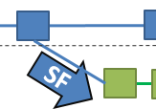
Are these rules enforceable?
To Trespass, Need:
51% Miners (else, funds stolen)
Interested, Fee-Paying Users
Code to have been written by Developers
Consequences of Trespass: Bitcoin users not affected. Bitcoin miners will be affecting each other for the duration of the “transgression”.*
Fundamental Q: How interdependent are mining activities?
Notes:
And I’d just like to remind everyone how much work it is to write, and support, blockchain software. You might think that this point is fragile in a systems sense, ie once someone writes the software, then this veto is gone. But all software has bugs, even Bitcoin, and since money is at stake (real Bitcoin, in this case), those bugs will be found. There will be DAO-type events, on bad sidechains. It’s easy to write this off, but I think it’s actually a powerful veto.
I’m not going to call it an “attack”. Potentially, at this level of abstraction, one man’s attack is another man’s feature. On one hand, the restriction may be preventing harm, but, on the other, it may be preventing us from doing something we all want to do.
Only if they have >50% going along with them. If the miners aren’t willing to act in the coin’s best interest, ie the Bitcoin price, thematically is a 51% attack against Bitcoin. Just a much more ambiguous one – and more dangerous for that reason. The ambiguity is potentially low, and fleeting.

Slide 29
Are these rules enforceable?
“Tame” Sidechains
To Trespass, Need:
51% Miners (else, funds stolen)
Interested, Fee-Paying Users
Code to have been written by Developers
Consequences of Trespass: Bitcoin users not affected. Bitcoin miners will be affecting each other for the duration of the “transgression”.*
Fundamental Q: How interdependent are mining activities?
Add new features to Bitcoin.
Contracts are firewalled – opt in, and don’t affect each other.
Contracts are managed, to maximize BTC value.
“Aggressive” Sidechains
All the benefits of “Tame”...and:
Permissionless Innovation.
No debate over precise “split” of validation resources (MB, SigOps).
Notes:
Because they’re governed by the miners.
Even though it’s not fully Permissionless, because you have to get the permission of the miners. The miners must, in the long run, maximize Bitcoin’s value, or else they are fired by the protocol. Miners that bring in less revenue are eventually eliminated.
Believe it or not, there is some finance magic, smart contract magic, where you can prove that an idea will increase Bitcoin’s value.
They have to be actual “innovations”, where that’s defined as “a better way of doing something”. Where better is defined as: Bitcoin’s price goes up.
We want to live in a world where trespassing is OK, and doesn’t harm Bitcoin.

Slide 30
Agenda: Part 1
The Problem (11)
One General Solution (3)
Is this GS Robust? (5)
Beyond The Limits (5)

Slide 31
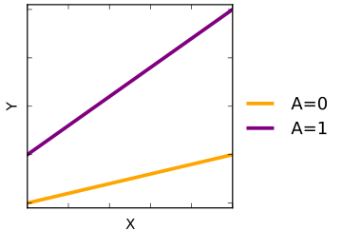
Mining Interaction
#1
#2
#3
#4
{ Power, Node Costs } 12.6 BTC
{ Power , Node Costs } 00.3 BTC
 |  | Capital |  |  | Operating | Network
 |  | Hardware | Software | Know How | Power | Bandwidth | CPU / RAM / Storage
Capital | ...
 | ...
 | ...
Operating | ...
Notes:
Revenues – gets it’s own section.
This is a table of mining elements. It has the same Row entries as Column entries, I’ve just cut the table off, because theirs not enough space. Anyway, the idea is, can one protocol affect the other. For example, say they’re both miners, the both run all profitable sidechains, but: the row player wants to run all sidechains, and the column player only wants to run Bitcoin. Where’s his complaint going to be?

Slide 32
Costs -- (Non) Interaction
Don’t Interact With Anything
 |  | Capital |  |  | Operating | Network
 |  | Hardware (excl. BW) | Software | Know How | Power | Bandwidth | CPU / RAM / Storage
Capital | ... | Indep. | Unlikely | Sub-Additive | Indep.
 | ... | Indep. | Unlikely | Sub-Additive | Indep.
 | ... | Indep. | Unlikely | Sub-Additive | Indep.
Operating | ... | Indep. | Unlikely | Sub-Additive | Indep.
Hashrate is shared, for free.
How costly is it to run (more) software? Given from devs.
How much marginal knowledge is req’ed to add sidechain.
Notes:
Doesn’t cost the ASICs any more electrical power to merged mine.
If you know how to do that for one, you know how to do it for all.
The software red-flag is that, like all Bitcoin-related software, someone can sneak in malicious code. We are no more vulnerable, in this case, than we would be in the case of any soft fork.

Slide 33


Interaction(?)
What you buy.
What others buy.
 |  | Network
 |  | Bandwidth | CPU / RAM / Storage
Network | Bandwidth | ? | *
 | CPU / RAM / Storage | * | Economies of Scale
Notes:
Production economies of scale, standardization / specialization.
If anything, you get to save on shipping, can reuse power supply unit, boards, make use of idle facility-space / labor-time, etc.
Bandwidth gets it’s own section.

Slide 34
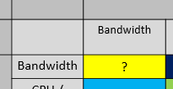
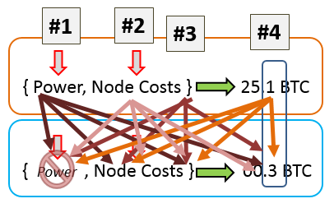
Miner Inter-Dependence
Bandwidth
(#2 x #2)
Fees
(#4 x #4)

Slide 35
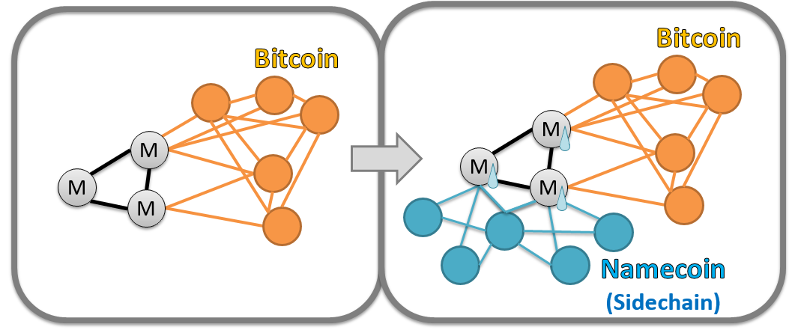
Conclusion: Sidechains convert miners.
$
$
$
Nodes are safe.
Miners not harmed…
But, miners are changed. They “must” absorb pSCs.
Notes:
Now, remember, the whole point of the analysis is take anyone who uses Bitcoin Core and make them feel at least indifferent, to the arrival of sidechains.
“Sure, maybe you don’t want sidechains, but you can go to sleep at night knowing that they won’t bother you.” And I’ve pointed out two features of Drivechain specifically….[1] miners are really the only shared link, between separate sidechains. Because they must share a PoW algorithm. The node costs are internalized, the mining is shared. [2] Miners can opt in /out of sidechains at will, therefore they will run all profitable sidechains.
So, at least, if the miners hate the chain, they can just bail on it. So the chain can’t hurt miners, and it can’t hurt node-operators. But, the deal is, sidechains *change* miners and maybe we don’t like that. Hence the first section which prevents the change.

Slide 36
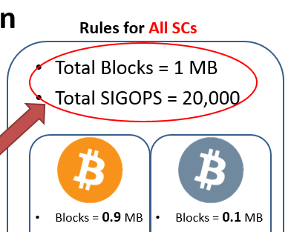
Conclusions
Result 1: Total effect limited to “mining conversion”.
Result 2: Possible for Total_Effect = 0.
Notes:
Effect one – miners much chase revenues

Slide 37
Conclusions
Result 3: Worst case, trespassing res. limits will cause miners to affect each other.

Slide 38
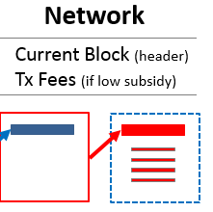
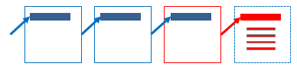
Bonus Points: Operating vs Startup
Sidechains need [1] nodes…
( Sidechains can use UTXO snapshots /
checkpoints…and delete old history. )
…but they don’t necessarily need [2] an entire history.
(While Bitcoin needs whole [growing] history, sidechains may
only need a smaller, fixed amount [of space]).
Notes:
Basically, since you’re trapped in SPV * security mode, anyway, you can occasionally checkpoint in with Bitcoin.
Bitcoin Mainchain can do the global accounting -- the inflation schedule, -- the 21 million coin limit.

Slide 39
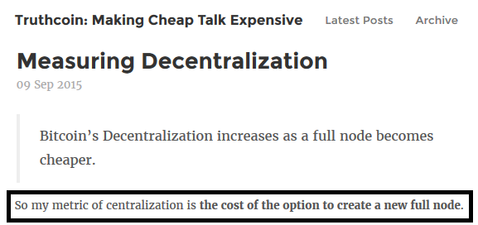
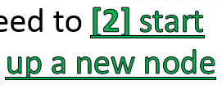
Op < St
Cost Mismatch: Operating < Startup
…but this continues to work in our favor.
Smaller “Op” burden, on the shared miners.
Meanwhile, users suffer the larger “St” burden.
Notes:
My view is that [2] “cost of using the node option” (or CONOP) is the measurement of Bitcoin’s decentralization.
Is this a problem?
Existence of Node-Alternatives | Ability to Create Node → Node Usage → Service Usage → TX fees
Bitcoin “Core Users” *still* are in exactly the same position they’re in now. Compare to Namecoin.
It “hits” the *users*, and users are the ones who set the protocol limits (or lack therof) for each sidechain. Hence the focus on
Externalities.
I say, if you want to create a Bitcoin Unlimited sidechain with no blocksize limit, and people full it full of giant spam blocks just to troll you, hey lesson learned, the hard way.
“As long as there’s a base layer Bitcoin hanging around.”
Bandwidth: they’ll find the miners, and kill them. Again, this is actually not a problem. It means that the miners should stop adding sidechain junk, if it will get them killed. If they risk it and die it’s their own fault.
They also have an incentive to upgrade TOR or purchase special bandwidth or whatever. Costs, Benefits, and Information, the Ownership and Control, reside in the same agent.
..but..if you absolutely insist.

Slide 40
Part 2 (Interlude): The Docile Miner
How relevant is Mining to Mainchain Bitcoin investors and users?
Mining is innovative and important. Miners (and their decisions) aren’t.
Only talking about the Mainchain.
Notes:
I don’t know why people care about miners. I get why they care about “Bitcoin” which contains an invention called “mining”. Now in the next section, I’m going to talk about block propagation and kind of stab this section in the back. So there is a specific problem with Bitcoin that needs to be fixed. But in general mining isn’t worth talking about.

Slide 41
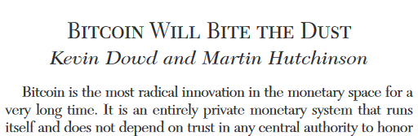
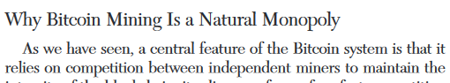
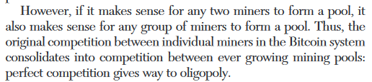
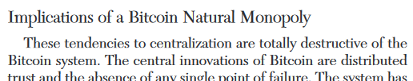
Often Heard
Point about Miners → Point about Bitcoin
Notes:
This section is an “interlude”, it is mostly directed at people who think that mining is incredibly incredibly important to Bitcoin. If you already know a lot about Bitcoin you might want to skip it.

Slide 42
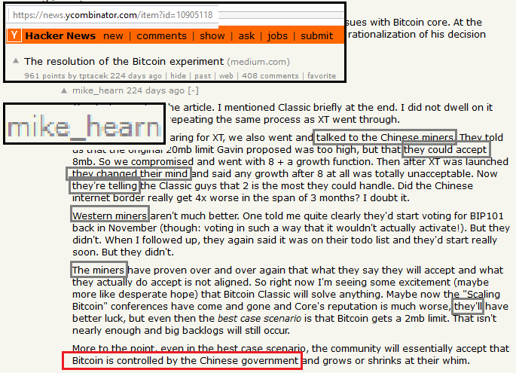
Often Heard
Point about Miners → Point about Bitcoin
Notes:
That’s a dark place, Mike. Go for a run, get yourself some chocolate or something.

Slide 43
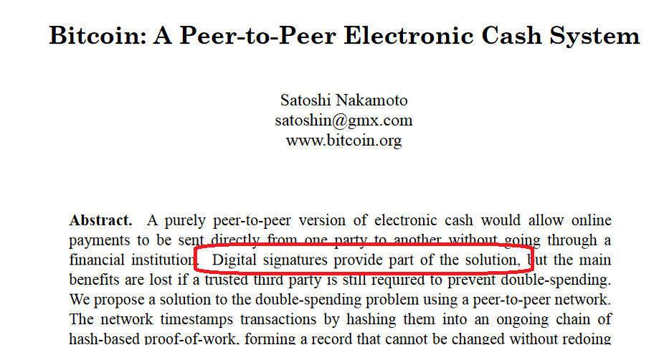
Bitcoin != Mining
Pre-existing Ideas
M
Notes:
Not merely proof-of-work, Dr. Adam Back invented that. Satoshi invented this fun way to use proof-of-work, and store it up, and measure it cumulatively, and intertwine it with a monetary system.
That’s this M part, that’s what the paper is mostly about – not because it’s the most important thing, but because it was the only new thing. There’s plenty to read about public key cryptography, BitTorrent, hash functions, whatever. Those things were already invented.

Slide 44
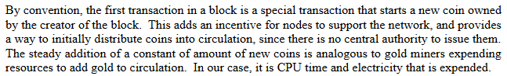
We’re >50% Done Already -- The Purpose(s) of Mining
Support Network
Distribute coins slowly.
More important.
(never affected by any centralization)
Unaffected by sidechains.
Notes:
If you’re going to create a new form of money, your biggest threat is that someone copies your strategy. You have to release the coins somehow. Without the *delayed* release of coins –ie some per block-, it would be very difficult to convince newcomers to join this network, vs start their own. .. We need to coordinate on one single network, if the concept of “double spending”.
“given them all to himself and his friends” the failure of Bitcoin would have been guaranteed! And I only bring that up because, this function, of distributing the coins, is completely unaffected by sidechaines, merged-mining, miner centralization, China, network propagation delays or whatever. So we’ve got this more-important one locked down. Which is probably one of the reasons why no one talks about it.

Slide 45
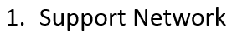
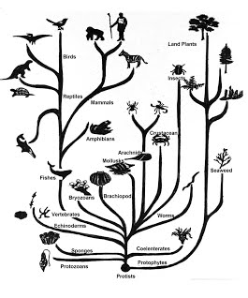
“Mining” (Process) vs. “Miners” (Agents)
Mining is important, miners aren’t.
NYC Restaurant Scene
Accountability Redundancy /Recovery
Competition (Process) vs. Competitors (Agents)
Indifference → Health
Scale Fallacy, Anti-fragility.
Notes:
If you did, you’d have some identity-based thing. This has no identity, no memory, it’s 100% merit based.
This is not a contradiction. It’s very similar to the distinction between competition and competitors.
Each individual restaurant is in constant mortal peril. A huge percentage of NYC restaurants fail in a given year. However, in plural, the restaurants in NYC are quite good. You can get cheap food or expensive food, in an endless variety of types and locations, hours. It delivers food perfectly.
The whole point of maintaining **competition** is that YOU don’t worry about the individual competitors. The more indifferent you are, to each individual, the healthier the group.
Evolution is good for “life”, in the sense that it produces a wide variety of life forms, of all shapes and sizes, to fill a wide variety of evolutionary niches. Our species even made it to the moon. But our species could only evolve because Mother Nature stood by and watched, indifferently, as species died by the millions. Six or so extinction events where >75% of the species died, two where over 90% died. But the only reason Dinosaures ruled the earth is because an extinction event wiped out their competitors, and the only reason large mammals exists. Because it’s easy for one class, to monopolize the “large terrestrial” sector.
Death is the magic that makes life possible.
If someone passed a law saying that “everyone has to order one loaf of bread, per week, from XYZ supermarket”. That would be good for the competitor (for XYZ supermarket), but bad for competition. “Supermarkets” as a whole, would get worse.
So, remember to hate individual miners.
So, if you are worried about Bitcoin, a smarter thing would be to “zoom out”, back to this outer level, and worry that major governments will invent their own version of private, fungible money.
It’s good to worry about “competition”. For example, if someone passes a law saying that the restaurant owners can all conspire to fix prices, that would be bad. But only a truly ignorant person would worry about “NYC restaurants” in plural. When one fails, another one opens. Because there’s a feedback process.

Slide 46
“Mining” (Process) vs. “Miners” (Agents)
Mining is important, miners aren’t.
A process, where anyone could join.
The people who did actually choose to join.
Amazing! Wonderful!
Boring. Pedestrian.
Irrelevant.
NYC Restaurant Scene
Respond to attack by:
Wait for new miners (easy - ACJ).
Require additional confirmations.
(Change mining algorithm.)
Competition (Process) vs. Competitors (Agents)
Indifference → Health
Scale Fallacy, Anti-fragility.
Attacker wins, buys miner’s hardware, or just coerces miner.
Notes:
Let me try to emphasize this distinction.
We can expect miners to come back, because the profit motive is there, and there’s no barrier to entry. So the network will regenerate, all by itself.
We can require additional confirmations, while the hashrate is suboptimally low.
But we really mess up any specialized attacker.
..but the attacker wins against this single miner. The attacker doesn’t necessarily win against anyone else. Mining is defined in advance, in the whitepaper. Most complaints about things that miners choose to do. Let me give some examples of things I don’t care about.

Slide 47

“Chinese” Co-location
Efficiency improvements (hashes/$) are good.
Specialization maximizes security, specifically vs. “rented” hashpower (Botnets, AWS).
Miners must take all EIs, to remain competitive.
Miners are like plants.
(On AutoPilot.)
Complaints about location =
complaints about ASICs =
complaints about efficiency. All miner-choices are efficiency-maximizing.
Notes:
Some people complain about the fact that some miners choose to post a message on the internet claiming that their physical mining equipment located within the borders of present-day China.
I have nothing but contempt for this concern. Firstly, locations = ASICs. For fixed $, this helps.
If we didn’t have this, it would be cheaper to attack Bitcoin, potentially much cheaper, from China.
I summarize my complaint with this image. It is a plant doing this funny thing indoor plants do.
This vector, pointing at the window, represents China/ASICs. Miners bend the blockchain toward the window. Most cheap power / capital controls are there. This is just the health maximizing direction.
A truly ignorant person might worry “hey! My plant isn’t growing straight, there must be something wrong with it!” That’s nonsense, the enemy’s gate is down, toward the light *is* straight. More nutrients for the plant, it doesn’t care about posture.
I mean, an attacker would select the most efficient equipment, and place it in the best location. So, why wouldn’t we?
Some people worry that the Chinese government will seize control of all the mining equipment, we’ll get back to that. But, for better or for worse, there has to be a “best location” just as their has to be a “best ASIC design”.
Others might complain: this is just a plant, following chemical feedback cycles. A human has way more autonomy! ..not really.
No. The reason your plant is doing whatever, is because the plant wants more sunlight. Similarly, the Chinese mining gives us the most hashrate per dollar. So Chinese mining is maximizing security. The shift from Everywhere to China, is no different than the shift from Every chip to a few ASICs.
Don’t worry about what the miners choose to do. Don’t interfere with their individual hardware choices, or software choices, or location choices, or management choices. Or that they use some new mining technique.

Slide 48
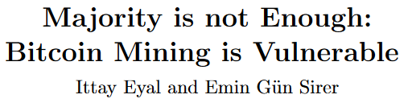
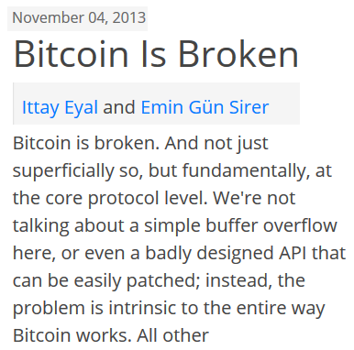
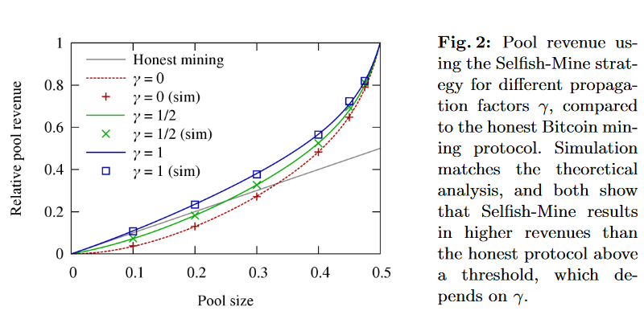
Improvements in Mining Strategy
Complaints about strategy =
complaints about ASICs =
complaints about efficiency.
Notes:
The same is true for all mining strategies. People publish these…they’re only interesting if they lower the miner’s cost of a 51% attack, which this one does not. Theoretically, with this strategy, one mining pool can ‘get ahead’ and ‘stay ahead’…but it does not help that pool pull off a 6 or 10 block reorganization.
I just have to say, in the interest of honest discourse, … Since the date this was published, Bitcoin has managed to run successfully for 34 consecutive months.
The discovery here, which “may” have been plagarized from a late-2010 bitcointalk.org post, is that: there are creative ways to mine, which increase revenue sometimes.
But these revenue-increases, are no different from any other efficiency improvement. No different from building a better ASIC.
If it works, everyone will just do it.

Slide 49
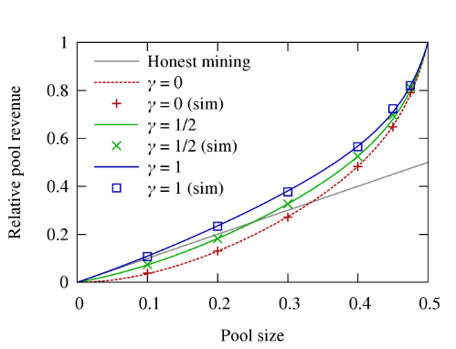
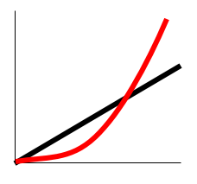
A Majority is Always Enough
= You
= Rival
2
SM is too effective at >50%.
45%
.75 → 0
60%
50%
.25 → 1.00 - ε
* New = Before – Headache
* Rel Efficiency: 0% or 100%
* Folk Theorem
15%
55%
0 → ε
40%
Notes:
This very graph proves that A Majority is Always Enough.
First of all, we know –empirically- that this is wrong, because no one has been doing it in the last 34 months – or, if they have, it doesn’t seem to have mattered to anything. But the question is why? Well, there’s a Folk Theorem result against selfish mining. We’re going to talk a LOT about the folk theorem later, but let me just go through this quickly.
Forming a bigger pool, and copying the selfish-mining strategy, the same way you might copy an ASIC design. So this person is on red as well.
So you say, well, I’ll argmax this graph, and make a 50% pool, the biggest pool around. And your rival player responds, by copying you. There are now two pools, selfish mining. Neither of them has any advantage relative to each other. ( Equal footing on this graph. ) It’s just a more annoying way of mining, with no benefit, which is –I suspect- why miners have tacitly agreed not to do it.
Now you might we wondering, what if someone makes a 60% pool. Well, SM is actually too effective, in that with 60% you get 100% of the blockrewards, and rivals get 0% for their 40%. This situation, far from being a decisive victory, is a powder keg, ready to explode. The fact that they happen to be currently losing, does not change the fact that their mining equipment is valuable.
These people are getting nothing, so they can be bribed with a mere epsilon.
Not bogged down.
Again, I emphasize that no actual efficiency was created, it was only relative. Relative efficiency improvements, will either be adopted by no one or everyone

Slide 50
Miners Can’t Do Very Much
Abilities
Individual miner can only filter transactions…for their block.
51% Miner-Group can only order txns.
Decision Criteria
Txns have no identities nor context. As a result, there’s no basis for arbitrary censorship (only for economic rationing). This is ideal!
With 51%, miners can (try to) reorder / re-filter txns in the immediate past. At tremendous cost / risk.
Inabilities. Miners can never:
“Steal” (Move money without a private key).
“Print” (Mint BTC, in excess of the pre-determined schedule).
Profitable Attack
Miner must double-spend with their funds.
…yet, attack affects all funds. (Attack must pay off, big!)
How many confirmations? Subjective answer = strategic response.
Notes:
By what criteria, might they exercise these abilities.
If the attack fails…which it might for several reasons (double-agents, bad luck, manual intervention), the attacking miners lose, rival miners win. Another risk is that the attack succeeds, and -as a result- all mining equipment loses much of it’s value.
So, life is tough for the miners, they’ll have to give up the security guarantee everywhere, to attack once with one bundle of money.
So, precisely as Satoshi advises in the whitepaper, if transactions are important, individuals should wait for many confirmations.
It’s one of my favorite things about Bitcoin. Can decide “conditions have worsened, I now need 10 confirmations” …makes attacks like this extremely futile.
Most physical things, goods-durable goods that you’d buy- have a long shipping time! Way more than 10 confirmations. But, what else? Well, consider the exchanges. It’s too slow, to our tremendous benefit, to move and withdraw USD for example.
The point of this slide is that miners have a very low ability to take any mean action. Assuming sufficient fungibility.

Slide 51
Miners Can’t Do Very Much
Abilities
Individual miner can only filter transactions…for their block.
51% Miner-Group can only order txns.
Decision Criteria
Txns have no identities nor context. As a result, there’s no basis for arbitrary censorship (only for economic rationing). This is ideal!
With 51%, miners can (try to) reorder / re-filter txns in the immediate past. At tremendous cost / risk.
Inabilities. Miners can never:
“Steal” (Move money without a private key).
“Print” (Mint BTC, in excess of the pre-determined schedule).
Profitable Attack
Miner must double-spend with their funds.
…yet, attack affects all funds. (Attack must pay off, big!)
How many confirmations? Subjective answer = strategic response.
With Lightning Network, miners cede even more of their influence (to users).
Notes:
Within certain parameters, you never have to touch the blockchain again, which means you never need to interface with miners again.
And, if you do need to check in with blockchain, you can do so with much better privacy, and only needing to sneak 1 or 2 things into the chain, and you have 1000 blocks to do it. It’s hopeless…why would anyone complain … this is a fortress.

Slide 52
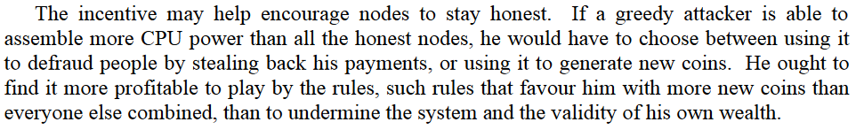
The Short Leash
Competition erases profits.
Best practices are copied, by rivals.
Rivals compete, benefits pass to consumers.
Un-copy-able resources become “rents”.
Mining is extremely competitive.
Anyone can join (ie, anyone can provide hashes).
Every hash has an equal chance of winning.
Profits will constantly be erased, by difficulty increases.
Miners more resemble Subsistence Farmers.
“Contestable Market”
Notes:
I feel bad for the miners, anything good they do can be copied. There’s plenty of cold Chinese mountain-land to go around.
The only real exception is: Secret chip design / facility design. Or some kind of bribery/theft/negotiation skill, for electrical power.
Such “mining secrets” would indeed prevent anyone from joining. But these secrets will leak, eventually, or be rediscovered. As a result, miners will be competing until Judgement Day.
And, every two weeks, the bottom performers will be cut from the team. It’ll never stop.
Which is why I call them subsistence farmers, and they have about as much autonomy as algae. Not a lot of freedom in general.

Slide 53
The Short Leash
Changing the PoW hash function.
Competition erases profits.
Best practices are copied, by rivals.
Rivals compete, benefits pass to consumers.
Un-copy-able resources become “rents”.
Mining is extremely competitive.
Anyone can join (ie, anyone can provide hashes).
Every hash has an equal chance of winning.
Profits will constantly be erased, by difficulty increases.
Miners most resemble Subsistence Farmers.
A trivial detail for programmers,
a temporary inconvenience* for users,
permanently devastating for miners.
Never, has a greater asymmetry existed between producer and consumer. The miner’s ASIC equipment is in perfect competition…with a near-infinite family of hash function combinations.
*We can improve.
“Contestable Market”
Notes:
It get’s even worse, though!
I mean image you call up your internet provider, and cancel your plan. That’s bad. And everyone might cancel their plan and the ISP could go out of business.
… So, these people are not in a position to make threats.

Slide 54
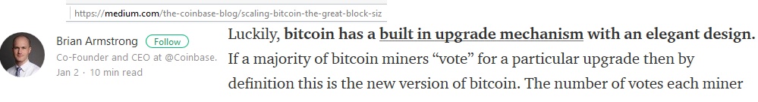
The Flow of Influence
Satoshi / Developers
Influence
Design
Utility
Quantity of Mining
User’s transactional need for BTC.
Users
PP of Blockreward
Spot Price
Time
Intertemporal Arbitrage
Investors
Users give away “real” goods and services…for digital tokens.
Expectations of future usage drive “buying of BTC”.
Miners are lowest on the “hierarchy of influence”.
Notes:
Not quite, and, for hard forks, the statement is outright false, this statement implies that miners have influence. I’d like to clarify this.
This graph has time from left to right, but influence from right to left.
Lets examine this spiral here. First, Satoshi had an idea. The idea aimed to address certain User’s needs, in the future. “The root problem with conventional currency is all the trust that’s required to make it work.”
Why would people do this? There must be some reason, something they *get* out of using Bitcoin. Maybe they’re only using Bitcoin as an intermediate step, and will swap them for dollars. Maybe it’s philosophical, maybe it’s privacy, maybe they want to store money in a brainwallet. The point is: people want Bitcoin, in the future. People will need Bitcoin at various times, in various quantities. The dearness of this need, desperation, varying magnitude. Big mixture of price-quantity combinations, at many future time periods.
This mixture means that investors can come in, and take advantage of price disparities. Just as arbitrage is done today among several exchanges, it can also be done across time-periods.
Mining does not cause anything. It’s the effect. It’s a reflection, or a shadow of this value. We saw this effect, with Ethereum Classic. Ethereum split into two, ETC –originally- had almost no price, almost no mining. It was then listed on Poloniex, where it’s price began to rise…and the hashrate quickly followed the price upwards. In Brian Armstrong’s world, the ETH-F miners would have just “decided” on the new version of Ethereum. But it’s actually the market that decides.
For soft forks, the miner’s filter some messages from the network. Almost 100% of these soft forks belong to two categories: [1] bugfixes, [2] optional opt-in features. So, in these cases, the price-maximizing decision is clear.

Slide 55
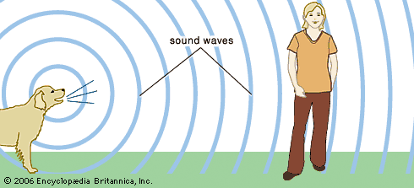

Miners As Waves
Stimulus = { Spot Price of BTC, Mining Tech & Best Practices }
Customer is a single numeric function – no substitutes, no excuses, no differentiation, no creativity, .
Notes:
As far as I’m concerned, miners don’t actually make any decisions or take any actions. They’re just a reflection of the state of the world – and a very, very simple reflection at that. They chase value, if they don’t, they don’t get paid, and –eventually- they start losing money.
Of course, this is somewhat true for all businesses. But mining is distinctive – [1] mining sells to my computer,
You deserve to know!

Slide 56
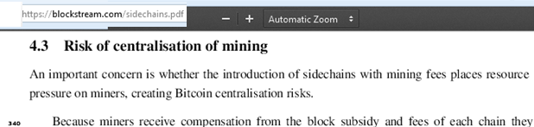
Conclusion
Users have a safe relationship with miners.
Miners don’t have many decisions to make:
Supply hashes? Include tx? Attempt double-spend?
Miners must walk “the path of efficiency”, improving their hardware, software, location, strategy, (etc) .
Miners are on a short leash.
Mining is caused, it is not “a cause”.
Anyone can mine.
Anyone can become a peer.
Progress sans identity.
Node Network
Mining
Notes:
If they don’t they won’t be miners for much longer, by definition.
Cause by a money-auction.

Slide 57

Part 3 - Bandwidth
Isn’t bandwidth just another full node cost?
If not, why not?
Notes:
Now this is going to be fun because I’m going to contradict my general comments about mining…with some specific objections.
Why isn’t bandwidth

Slide 58


Bandwidth – Beyond the Limits
What happens to mining, on mainchain Bitcoin?
Notes:
Early work:
https://bitcointalk.org/index.php?topic=144895.0
http://bitcoin.stackexchange.com/questions/1338/how-is-block-solution-withholding-a-threat-to-mining-pools https://bitcoil.co.il/pool_analysis.pdf

Slide 59
Bandwidth – Beyond the Limits
What happens to mining, on mainchain Bitcoin?
Notes:
Edit this slide --- Bitcoin is asymmetric, and privledges the Mainchain.
So, if there are problems, Core will probably die last, and the problematic sidechain(s) will probably die first.
But I think we can do better. I think we can eliminate these problems.

Slide 60

There’s something special about “propagation”.
Or, let’s call it “connectivity” or “bandwidth”.
Compare the non-special: labor, power, hardware, cooling tech, land.
These are internalized: Improvement = higher profits.
Notes:
Bahack – Selfish Mining http://arxiv.org/pdf/1312.7013v1.pdf

Slide 61
Section Agenda
Problem (9 Slides)
Other Research (4)
Solution (7)
Safety (4)
Improvements (2)

Slide 62


Inherently Interpersonal
Just as a chain is only as strong as its weakest link, a
broadcast network is only as fast as its slowest bilateral connection.
* [12] ------------ [12] *
* [35] ----------------------------------- [35] *
Block Withholding (“Selfish Mining”) is intentional bandwidth manipulation.
As is a 51% attack to create lengthy reorg.
Notes:
[start]
In some ways a sidechain is like any other bandwidth-using application on your computer. If your internet is bad, you will have trouble streaming video on the internet. That’s mostly your problem.
However, there’s another sense in which it is someone else’s problem. Bandwidth is like distance, if… you are further away from them, and they are further away from you. It sounds platitudinous, but it’s actually quite important. If you upgrade your CPU, it doesn’t downgrade rival CPUs. And it especially doesn’t do so immediately and directly.
Ultimately, if we get too far away from each other, some people won’t be able to catch up. They’ll split off into their own network. Fortunately, we are very very far from that limit. Almost everyone can manage to download a 1 MB / 10 minutes (1.7 KB/sec).
Nonetheless, this concept of ‘distance’ is important because it *does* affect the miner’s ability to mine. That ability of the miner to mine, is of course, the focus of our sidechain risk analysis.

Slide 63
Orphaning “Costs” - Bifurcation
Reward
Propagation Time
0.0
10.0
0.0
10.0
Hashrate In Your Trusted Group
< 50%
> 50%
1st: Download & Validate, 2nd: Start mining.
“ You wait. ”
Mine immediately.
“ They wait. ”
Notes:
This graph will appear twice. The idea is that “orphaning” behaves differently, depending on if you are in a majority-hashpower group.
Peter R tried to argue that ‘bandwidth’ was also non-special. He argued that inferior bandwidth led to higher orphan costs. He was, in fact, half-right, but unfortunately for him it was the wrong half.
“If you mine a block, will other’s trust it to be valid –immediately?”
If “you” mine a block: Yes.

Slide 64
The Propagation Paradox: Connectivity Down, Profits…Up?!
Planet: | Mars | Earth
Hashrate: | 75% | 25%
Txn Volume: | 10% | 90%
75% of hashrate teleports to Mars.
It takes 1 hour for messages to pass between planets.
(Mars miners are not necessarily coordinating with each other).
Notes:
Mars miners are not necessarily coordinating, they are not 51% attacking, or making any choices, and they might not even be aware that anything bad is happening. This can happen, in the real world, in a very slow, gradual, continuous sense.
So this is not a malicious 51% attack, this is just a normal thing…created by SPACE.

Slide 65
Paradox: Bandwidth Bad, Profits Up
H=75%
H=25%
In Transit
Mars
Earth
T = 1
0 mins
T = 2
1
2
3
3
2
1
1
40 mins
1
T = 3
1
2
3
6
5
4
3
2
1
1
2
80 mins
4
5
6
1
2
T = 4
1
9
8
7
6
5
4
1
2
3
1
2
3
4
5
6
1
2
3
120 mins
7
8
9
2
3
Notes:
Who’s to say which side of the network is the “real” network? Classic Byzantine Generals – which network is real – which txns is real?
Now we have some problems, because now an hour has passed between T=2 and T=4.
Note 1’s transactions, any novel ones which are still valid, will be included in the 7-8-9 string, so I put them in “8”.

Slide 66
Paradox: Bandwidth Bad, Profits Up
H=75%
H=25%
In Transit
Mars
Earth
T = 1
0 mins
T = 5
2
2
1
0
9
8
7
T = 2
1
2
3
1
2
3
4
160 mins
4
5
6
1
2
3
1
2
3
1
2
3
4
5
6
7
8
9
3
4
1
40 mins
0
1
2
1
T = 3
1
2
3
4
5
6
1
2
3
1
2
80 mins
4
5
6
1
2
T = 4
1
Earth’s miners can never find a winning block (vs Mars)!
By moving to Mars, they’ve defeated their competition!
Hence, to move to Mars?!
7
8
9
4
5
6
1
2
3
1
2
3
4
5
6
1
2
3
120 mins
7
8
9
2
3
incentive
Notes:
And believe it or not, not until the period after this one, that the poor people in Earthblock one will even receive notice that their transactions actually made it into the blockchain at all.

Slide 67
Incentive Glitch
Miners have an incentive to make their connectivity worse.
This “glitch” is principle behind all selfish mining variants (esp. where miners fill their own blocks), as well as the 51% attack.
Also, heart of the Byzantine Generals problem. “I didn’t get that message.” (sincerely?).
CoreDev complaints about “bandwidth”.
What’s going on? Can we fix this?
Notes:
It’s always so important, right? You’re always hearing about it.

Slide 68

Miners: The Dual-Role
Miners “sell” blocks to the network...
...but who is “the network”? ...who’s buying?
Miners, also!
A block is Bitcoin if it is part of the heaviest chain, so ... “Buyers” = Network = 51% of the future hashrate.
Notes:
Normally, buyer and seller are different people. But Bitcoin is Peer to Peer – there’s no identity and, hence, everyone is the same.
Heaviest “valid” chain. Today’s miner is selling to tomorrows miner(s).
The 51% group is real, and any connectivity issues are the 49%’s problem.

Slide 69
Orphaning “Costs” - Bifurcation
Reward
Propagation Time
0.0
10.0
0.0
10.0
Hashrate In Your Trusted Group
< 50%
> 50%
1st: Download & Validate, 2nd: Start mining.
“ You wait. ”
Mine immediately.
“ They wait. ”
Notes:
“If you mine a block, you want others to get it fast, otherwise it might get orphaned.”
If “you” mine a block: Yes.

Slide 70



Other Research
Notes:
Here’s Peter R’s paper. This is Peter’s supply curve for blocks. He is saying that bigger blocks are more expensive, due to orphaning.
Advance slide

Slide 71

Consistency
0
0
Independent of Q
Notes:
If You ARE the other miners, that time is zero.
However, I don’t agree that the answer should be zero, it should actually start getting negative.

Slide 72

Notes:
There are some assumptions made, and some questions raised as a result of those assumptions. We’ll see that they were very relevant.
Advance slide

Slide 73

No SPV
Pre-Propagation, “Scheduled Blocks”
SPV mining
Equilibrium Behavior
Externality Problem
Notes:
So, this SPV mining brings me to my next point.

Slide 74


Fixing the Incentive Glitch
Notes:
https://www.reddit.com/r/Bitcoin/comments/3zzlk4/spv_mining_is_the_solution_not_the_problem/
Let me define SPV mining very carefully. Someone else, announces to you that they’ve found a block, and they send you the header. You check to make sure that the header meets the proof-of-work requirements, and then you immediately start mining on this new block-header. So basically, you skip the transaction stuff – you don’t download or validate any transactions.
This is a very clever trick for a few reasons. My favorite reason is that it takes ~~just as much work to produce an invalid header, as it does to produce a valid header. So the headers are very expensive to make ..10 minutes of PoW .. Whether they are valid or invalid. So, you can’t be spammed with fake headers, and it’s unlikely that anyone would intentionally construct a bad header. Because they’d lose a block by doing so –ie, the opportunity cost of finding a real block.
In order to profitably use this “invalid block” to fake you out, they’d need to somehow use it to distract you such that they can find 2 blocks while you’re distracted. I think this is impossible, under any sane network conditions.
So the only concern is that a bunch of unintentional fake blocks are made, and that these somehow damage the network.

Slide 75
Orphaning “Costs” - Bifurcation
Reward
Propagation Time
0.0
10.0
0.0
10.0
Hashrate In Your Trusted Group
< 50%
> 50%
1st: Download & Validate, 2nd: Start mining.
“ You wait. ”
Mine immediately.
“ They wait. ”
Notes:
But, how is this possible? Don’t we *need* the block, in order to mine on it?

Slide 76
“SPV Mining”
Proof-of-work is done on headers (not blocks)!
Headers are 80 bytes. Travel time near-instant.
Work( Invalid Header ) = Work ( Mine Valid BTC Block )
Headers: expensive to fake + teleport instantly.
Strat: [1] Notice new header. [2] Mine on it. [3] Meanwhile, download and validate its block. [4] Post-validation, insert all (still valid) txns.
Notes:
One gets 25 BTC for a valid block, but 0 BTC for an invalid header. A fake header thus “costs” a whole 25 BTC (soon to be 12.5). How could he use this to make >25 BTC ? He’d need to find 2 blocks while they were distracted. Even with a whopping 50% of the Hashrate, this would take on average 40 minutes.

Slide 77
Space Ex. w Teleporting Headers (& Fast Coinbases)
E = empty
(or “epsilon”)
In Transit
Mars
Earth
T = 1
0 mins
T = 2
E
E?
E
1
2
3
4
3
1
E
1
2
3
4
40 mins
4
2
T = 3
E
E
E
1
2
3
8
7
5
4
3
1
E
E
1
2
3
4
80 mins
4
5
6
7
8
5
6
7
8
6
E
E
T = 4
E
1
0
9
8
7
5
1
2
3
E
1
2
3
4
4
5
6
7
8
9
E
120 mins
E
5
6
7
8
9
0
0
1
2
0
1
2
Notes:
Same example, just with 80 byte block headers that teleport instantly. Moreover, coinbases (which are the only transactions in an empty block), propagate very quickly.
Best case, the coinbase is one BTC address, which 20 bytes (four times smaller than the thing I’m assuming will teleport instantly).
Worst case it could be a big, P2Pool –ish transaction, which can take about 8000 bytes (the size of 100 headers, but still <1% of the full 1 MB block). [[ Piachu – “P2Pool and low power miners” ]]
E? = If Mars is worried that Earth is acting irrationally, and not following this scheme, Mars might either [1] ignore block 2, which would put us back where we were, or [2] they may themselves temporarily switch to “No TX” mode.
I don’t want the point to be bogged down by the details. The point is that Earth is back in the mining game.
Now, you may be thinking: Hey! Earth can never find any full blocks! The transactions do travel across the network, not in blocks but as network messages. Where Mars claims them.

Slide 78
The Propagation Paradox: Connectivity Up, Profits…Down?!
Planet: | Mars | Earth
Hashrate: | 75% | 25%
Txn Volume: | 10% | 90%
75% of hashrate teleported to Mars (where bandwidth is poor).
It takes 1 hour for messages to pass between planets.
(Mars miners are not necessarily coordinating).
Notes:
And, as I’m sure you remember from when I set up this example, 75% of the hashrate moved to a remote location, where most of the transactions WEREN’T.

Slide 79
For Subsidy (50, 25, 12.5) …
…problem solved.
Because:
Miners can now “mine a block”, at any time…
…but they can’t start safely including new txns, until they have latest txn data.
Notes:
No wasted mining!
Ie, the entire up-to-date blockchain.

Slide 80


Incentive Problem: Fixed
Should a group of 26% leave Mars to go back to Earth?
[1] fewer “epsilon txns”, [2] less e-tx competition.
Stay: 10% * ( 26/75 ) vs.
Return: 90% * ( 26/51 )
Incentive to…
…move to Earth.
…invest in connectivity.
…co-locate with tx-fees.
Fees drive miner incentives!
Notes:
Not only do miners have an incentive to invest *in* connectivity, because they want to get the block ASAP so that they can figure out which txns they can still safely include.
--but, also-- Miners have an incentive to co-locate w/ the tx-fees.
If a ton of economic Bitcoin activity sprung up on Venus, some miners would want to move there, because their blockheaders will still get through instantly, but they can beat the competition on Earth and Mars to grab those transaction fees, should the opportunity arise. And if a miner could build a private interplanetary highway, he could make use of it because he’d always get all blocks –like everyone else- but unlike everyone else, he’d be aware of the state of all transactions at all times.

Slide 81

Is SPV Mining “Safe”? (1 of 2)
Shouldn’t we force miners to validate?
( Don’t we, already? )

Slide 82

Is SPV Mining “Safe”? (2 of 2)
Or, is validation the *node’s job*?
If we aren’t running our own node, we are trusting someone else to validate for us.
Isn’t that anathema to Bitcoin?
Notes:
I say, we should *not* be trusting the miners. Or rather, the only reason we should trust them is because someone is checking up on them.

Slide 83

‘Bandwidth’ Will Continue to Improve
SPV Mining
Bloom Filters
FIBRE
UTXO Commitments
Block Scheduling*
Clever Transaction Strategies
Notes:
Recall that miners require [a] the previous block header, and [b] a way to make money –ie a way to include valid transactions into the block they’re mining.
[slide]
I cut Scheduled Blocks from this presentation. It was took long, and I think the more important thing is to clearly explain where the problem is.
Who really knows what these people are doing with their time? Tinkering, learning clever ways to mine. They live and breathe this stuff every day.

Slide 84



Clever SPV Optimization
“Hipster Mining”
Low Quality
‘Unpopular’ / Passed over by rival miners.
Notes:
If you’ll forgive me, I’m going to call this ‘hipster mining’. [slide] trying to pretend to be cheap , or even ironic. The ultimate goal is this: you’ve received notice that a new block is found, and you’ve received the header…you want guess which transactions weren’t included. That way you can take the header, include these passed-over transactions, and start mining immediately. We’re going for better-than-empty, but still valid.
Exploits all of the information available -- at the time the block is found. …without requiring the transaction data.
Miners can’t really attack each other, because they would be forgoing high-quantity txns. We don’t know if miners are actually doing this. But they should…it is a profitable deviation from the current behavior, and, once they start doing it, there’s no incentive to stop.

Slide 85


Canonical TX Priority
It helps if miners agree on the definition of “transaction priority”. (Semi-scheduled blocks).
Even crazier idea: pre-defining each upcoming block (across-block priority).
Notes:
Here’s one last, final, slide about this idea. [slide]
It doesn’t really matter how “bad” the definition is, as long as everyone agrees on it. ( The only req. is that miners pre-agree on the definition. The definition can actually be a very bad one, and SPV-M still works.)

Slide 86
Conclusion
We want to push bandwidth into the ‘full node costs’ category, but this is hard. Bandwidth is a distance between two people.
Ideally, Miners would always have up-to-date information.
SPV Mining
More Work Needed, But Promising Solutions Exist
Notes:
[slide]
Remember, if they’re in the full node category, then the problem is punted away. The designer of the sidechain, has to convince users and miners to bear these costs. And they have to convince miners that the value created –in tx fees as well as increased utility of Bitcoin– is worth the trouble.

Slide 87
Conclusion
Asymmetric
We want to push bandwidth into the ‘full node costs’ category, but this is hard. Bandwidth is a distance between two people.
Ideally, Miners would always have up-to-date information.
M
S
S
S
S
S
S²
S²
SPV Mining
More Work Needed, But Promising Solutions Exist
If bandwidth is to be increased, it might be safest to do so via sidechains.
Notes:
In Drivechain specifically, the chains are not symmetric. Ie, the two chains are not equal. The lower level S chain does more heavy-lifting, more computation / more organizing. And, again, the upper chain, ie anything with an arrow point toward it. Needs to *consent* to the very existence of the lower chain. It can terminate the relationship at any time.
And smash S2 and take all the money.
Regular, Core Bitcoin is superior. This is Core, at the top. So we might expect, no promises, if there are bandwidth-related problems, they might resolve themselves in one of these stages.
In other words, it’s very likely that the lower level chains will die first, if resources are insufficient. Mostly likely of all, miners will just announce that, there’s not enough bandwidth to go around and these will just down over the next month or whatever.
But again, my goal –in designing Drivechain- was to try and really push these problems away from the Mainchain and into each sidechain. And I think I mostly succeeded. (( Although they can all share one Lightning Network, which is the coolest thing ever. ))

Slide 88
Part 4 - Fees
Under what conditions will revenues fall?
How can we prevent this?
Notes:
Now this is going to be fun because I’m going to contradict my general comments about mining…with some specific objections.
Why isn’t bandwidth

Slide 89
Tx Fees – Beyond the Limits
What happens to mining, on mainchain Bitcoin?
Notes:
Previously, I argued that we can limit the impact of sidechains. And that this limit is incentive compatible, unless there is broad consensus to override it.
(And, of course, if there is such a consensus, you can override everything in the blockchain space). Next I pointed out that the impact is always to increase miner profits. If it causes profits to go up, miners will be compelled to do it. If not, then it won’t happen. If it accidentally happens anyway, it will be shut off.
Fine, now we’re going to talk about what might happen if we go..beyond the limits. Because we want an open door for permissionless innovation, so we want to show people that
My view is that many of Bitcoin’s full node e want to be sure that there isn’t some huge disaster looming over here

Slide 90
Section Agenda
Review / Assumptions (4)
Three Different Perspectives (5)
Bitcoin’s Transition (to Equilibrium) (3)
The “Market” for Block-Access (15)
Coase vs Folk -- Miner Coordination (9)
Demand Curve Calculus (8)
Notes:
6. Block Scheduling (??)

Slide 91


An OLD Topic
Notes:
It’s a topic which has fascinated and consumed the Bitcoin community since it’s earliest days. You can see here an important post from 2013. The debate goes on, and on, and it absolutely spills into the current blocksize debate. And, an important thing to say is that, while I strive to come up with original content, and I did as much background reading as I could, and I really think that this is new stuff. But there’s just no way I can guarantee that someone else didn’t say this already on Bitcointalk. .. It’s like the Library of Babel over there.

Slide 92
(Worst Case) Assumptions
That someone creates a sidechain of Bitcoin, with all economically-relevant limits removed.
The sidechain txns are perceived as perfect substitutes for Bitcoin txns.
This effectively removes Bitcoin’s limits.
Reminder: Bitcoin Core not directly affected.
Sidechains
Mainchain
indifferent
Notes:
Assume that externalities (ie, the bandwidth storage CPU costs) have been magically solved. -- because we want to make this situation as bad for fees, as possible.
[slide]
In fact, the main effect would be to *reduce* the transaction fees on Bitcoin Core . …and that’s the problem.
Because fees = security.

Slide 93




Fees = Security
Rewrite Cost = $Subsidy+\sum{Fees}$
DoS Cost = $\sum{Fees}$
Notes:
Clever thing here, it pools each individual’s transaction fee, with all the other transaction fees, and then pools all the block’s transaction fees into a big chain of cumulative work. Which is very cool.
Note that, fees *really* equal security, if you care about DoS. In that case, someone could send BTC to themselves, pay the full S fees, and

Slide 94

(Alternative) Assumptions
Characteristic | SC Demand Affects Mainchain... | Total Ecosystem Effect
Substitutes | …by removing need for a BTC tx. | ?
Independent | …(not at all). | Good – Increases Total Fees.
Compliments | …by inducing need for a BTC tx. | Great ! – Increases Fees 2x.
?
Notes:
But, let me just mention that, although we’ll be exploring this top row here, I don’t really believe most sidechain activity will fit this description. Instead, the sidechain will probably do something that Bitcoin can’t do, so people literally won’t be able to use the chains as substitutes. In these cases, the chains don’t affect each other, but total security (ie, total Hashrate) should equal the sum of all tx fees. So this is a good thing.
Even better, some sidechains may even help spread the gospel of Bitcoin. So as their demand increases, demand for regular Bitcoin will also increase.
But of course that’s no way to do a security analysis so we are focused on this question mark here.

Slide 95
Section Agenda
Review / Assumptions (Completed)
Three Different Perspectives (5)
Bitcoin’s Transition (to Equilibrium) (3)
The “Market” for Block-Access (15)
Coase vs Folk -- Miner Coordination (9)
Demand Curve Calculus (8)
Notes:
6. Block Scheduling (??)

Slide 96
Economic Limits
Price [tx fee]
(BTC / KB)
Supply
All Fees
In Block
Demand
Quantity (KB)
1000
Notes:
More or less the picture today.
This top edge shouldn’t be flat, because it implies that everyone pays the same fee/KB…which isn’t the case. But we are headed in that direction, more about that later.
But, basically, for every byte of a block, someone bought that byte, and they paid for each byte, in BTC.

Slide 97
Economic Limits
Price [tx fee]
(BTC / )
SIGOP
Could be several metrics at once, or one composite metric.
Supply
Doesn’t matter.
All Fees
In Block
Demand
Quantity( )
SOs
20,000
Notes:
But it doesn’t need to be KB. For example, it could be the number of “sigops” (ie, signature operations). These are also limited by the protocol, because they are relatively expensive for a CPU to calculate.
Ultimately, there are two filters, to get your message into the blockchain, One is the miners, who have the option of removing or ignoring any message on the P2P network. The second filter is the protocol rules, nodes will reject. All transactions must jump both hurdles to make it into the blockchain.
So these “hurdles” define the Quantity dimension.
I think / hope that this entire analysis holds up whether we use KB or SIGOPs or some combination of things – for this horizontal axis.

Slide 98
3 Perspectives – Life Without Economic Limits
P
Supply
P
P
Supply
Q
Market
(“Supply”)
Supply
Q
Q
Tragic
(“Commons”,
“Anarchist”)
Cartel
(“Managed”,
“Gouging”)
Notes:
Light blue is the original limit.
Dust limit, such that even if the only transactions are dust transactions, they will not be included in blocks.
We don’t know the slope, or intersection of this, but we do know the shape (because of principles of bidding, and sorting a set of numbers).

Slide 99

3 Perspectives – Life Without Economic Limits
P
Supply
P
P
Supply
Q
Market
(“Supply”)
Supply
Healthy
Q
Tragic
(“Commons”,
“Anarchist”)
Q
Cartel
(“Managed”,
“Gouging”)
Minimized
Maximized
Notes:
Note the completely different shape of each supply curve: one horizontal, one curved, one L-shaped.
And the completely different expectation of fees.

Slide 100
3 Perspectives – Life Without Economic Limits
P
Supply
“System doesn’t require management.”
P
P
Supply
“Management will maximize revenue.”
Q
“System will crash!”
Market
(“Supply”)
Supply
Q
Q
Tragic
(“Commons”,
“Anarchist”)
Cartel
(“Managed”,
“Gouging”)
Notes:
The perspectives, and predictions.

Slide 101

[2] Transitioning To Equilibrium
Early Days are Not Representative
Fees , Subsidy . Implies: fee/sub .
50
12.5
25
0.20
1
0.04
Notes:
“fees currently are low, in BTC terms, AND they can’t buy anything in the real world. Both will change.”
This shows a factor of 5, but it is accelerating. Actually, in the most recent two years the growth factor is 6. … 6 is more than 5, and two years is less than four.

Slide 102
[2] Transition to Equilibrium
What will change?
Miners will treasure blocks…for their Fees.
Growth Attitude will diminish, in favor of a (new) Adversarial Attitude.
Demand for BTC will increase and change (Hobby → Black Market → Home Network)
How Different will it be?
Notes:
“playing nice, while the system is young”

Slide 103


[2] Transition to Equilibrium
Conclusion: This will lead miners to engage in “revenue (fee) maximization”…
…which will lead users to engage in “fee minimization”.
Question: to what extent can miners fee-maximize?

Slide 104
[3] The “Market” for Block-Access
[3] Sub-Agenda
A “Normal” Market (6)
Abnormalities in Our Case (2)
Implications of these Abnormalities (4)
The Block Tree (3)
Notes:
We’re going to “zoom in” and look at markets in detail.

Slide 105
Preview: Per Single Block (Across Many Blocks = Complicated)
Price
(BTC / *)
Limit
Price
Demand
Supply
Quantity
(*)
Notes:
Demand curve is produced by “people who to want to broadcast messages”.
Supply curve is monopolistic, the supplier can make it assume any shape he/she wishes.
As a result, they can hit any point on the demand curve. Either by setting a resource limit, or by setting a fixed price.

Slide 106
[i] Normal Market – Demand for Oil
Price ($/gallon)
“Willingness to Pay”
“reservation price”
10k
(hard to measure)
4k
Quantity
(gallon)
3*
10
1,020
20
Notes:
Ok, we’re going to do a small review here. It is important to go over this, because we’ll need it later, when I argue that some of these important features aren’t in Bitcoins “fee market”.
This part, the demand, will generalize to Bitcoin, but the second part, supply, will not. So, we’ll warm up with this one.
First, the axes: the horizontal is the thing we are buying and selling, per unit. The vertical is the price per unit.
Now, let me explain the blue and green rectangles.
This guy, is throwing an expensive fundraiser in his Manhattan apartment, in the winter, and he’s realized he is out of heating oil. All of his rich friends will be there, they expect to raise millions of dollars for charity. But it’s cold and uncomfortable! How embarrassing. Now, he will go out and buy some for 3$ a gallon. But, he would buy 10 gallons (this width here) even if that 10 gallons cost him $100,000. Cause he really needs it. When this guy gets his fuel for the market price of 30 bucks, he’s going to be a happy camper.
This green guy, happens to be a wealthy businessman. He’s traveling when he learns that his father some kind of medical tragedy. He needs to fly back to his hometown immediately but he’s out of fuel. He needs to buy 1,000 gallons. He’d spend up to $4,000/gal, total cost 4 million dollars. But he’s rich and he needs to get back. Now, again, he’s going to be able to refuel the plan at market cost of 3 grand.

Slide 107
Normal Market – Demand for Oil
Price ($/gallon)
Quantity
(gallon)
Notes:
So that was just 5 people….but if you zoom out, one would expect something like this. Then you draw a line through it.
It always slopes down, by definition.
In practice, it is always curved –hence the name, demand curve-- , because its highly unlikely that every delta here is the same. All the big declines are first, the small declines are later.
Ok, this is the same, in Bitcoin land and Oil-land. But this next part is not going to be the same.

Slide 108
Normal Market – Supply of Oil
Cost (“Price”) ($/gallon)
Offshore Platform #1
Land Site #3
Variable Costs
(Operating, COGS)
Land Site #2
Average
Fixed Costs
(Capital, SGA
Variable
period costs)
Land Site #1
Quantity
(gallon)
Notes:
Ok, supply. This is where the analogy starts to break down. Ok this is a simple graph – exact same axes, as before. The lines represent different ways of forcing gallons of oil to appear.
So let me walk you through it. Say you want to use “Land Site #2” to make oil. Before you even get started, you have to pay this. This is the setup cost, economists call it fixed cost, accountants call it (selling general and administrative, assuming no debt).

Slide 109
Normal Market – Supply of Oil
Cost (“Price”) ($/gallon)
Quantity
(gallon)
“The Supply Curve”
Notes:
And, the idea is, same as with demand, you sort the different methods. You take all the cheapest methods first, and cheapest combinations of method, and you string them together to make a big curve. Long story short it’s drawn like this.
But not necessarily. There is a difference between the demand & supply curves – of universality.
Demand curve, by definition, includes everyone, it is necessarily universal, because anyone could “want” to buy oil. Maybe they want it for 0.00001 cents.
However, the supply curve isn’t necessarily universal, it might potentially just be one firm or one production method. Supply curve is specific to these people. Oil might compete with Tesla cars and electricity, or it might compete with natural gas heating, or it might compete with moving, migrating to warmer climate, or different building materials. There are lots of ways of “replacing” oil – so many that we don’t even bother. This is a narrow look at production.
The supply curve answers the question: “if market price is X, how much would be produced?”. But, in the case of monopoly, the seller can either just pick a price, or they choose a production quantity which implies a price. So the supply curve isn’t meaningful for a monopoly.

Slide 110
Features of Market Exchange
Competition
P
S
$3
$3.2
Rivalry (..for customers)
Stockout (..for suppliers)
p*
D
$3
Q
q*
$2.9
Notes:
This red horizontal is “The market price”, which everyone uses.
This triangular region is all the happiness people get. This sort of quarter-oval thing here is the profit going to producers, ignoring Paretian Rent (which we don’t have time to explain).
Emphasis on individual interaction – specifically: competition. Rivalry (for customers), stockouts (for suppliers).
Emphasis on quantity – it is an entire dimension (the horizontal dimension) of this analysis. Everything is expressed per unit(s).
Now, this “zooming in” I was talking about before.

Slide 111
[ii] Block-Access Abnormalities
Competition
No choice. Buyers don’t choose their miners.
No concept of “individual”.
Network is Public
Pseudonymous
Agent = User != Account
$3
$3.2
Rivalry (..for customers)
Stockout (..for suppliers)
$3
$2.9
Notes:
This *fundamental* idea, of a unique transaction, a unique single connection between two sovereign decision-makers. That doesn’t apply in Bitcoin…you just broadcast your message, --out, into the internet-- end of story.
[slide]
Not necessarily any relationship between an account and an individual. One user could have many accounts, one account could have many users (multisig). If a miner is part of a pool, is he the principal or the agent? Who’s in charge of what, who should you be negotiating with?

Slide 112
[ii] Abnormalities, cont.
Sellers (miners) don’t control block production.
Can’t “choose” to make more blocks.
Each block can, theoretically, hold ~+INF txns.
Sellers have nothing to sell!
Pre-Block, can’t guarantee that they will find one.
Post-Block, include/exclude policy can’t be changed!
Notes:
[slide]
So, Marty the miner can’t say something like, “pay me $5 and I’ll get your transaction into the next block”. That sentence makes no sense in Bitcoin.
Here’s a header. The header controls both [1] the timestamps and [2] the included transactions. Work is done on the headers.
In a nerdy way, I’m delighted to present on this topic because I don’t think a market like this has ever existed before. I mean, you thought the healthcare markets were weird.

Slide 113

[iii] Implications
Miners don’t compete on price.
In fact, there’s a “shared customer pool” and “shared production schedule”.
Notes:
No individuals, no choice.

Slide 114


[iii] Implications
“Blocks” are not the relevant “thing supplied”.
..?
Notes:
That one’s kind of obvious, but important to mention it. Blocks are just going to be found, as quickly as possible, which will be at a rate of about 2016 per two weeks. That’s always been the case and (hopefully) it will continue to be the case.
Within ever 2016 block period, you’ll find x blocks per hour, no matter what anyone else does. That’s very much *unlike* the oil example. If other people make more oil, it affects you.
#4…what is the implication of this? Think about it, before I advance the slide. Miners can’t tell a BTC-user “this is my tx fee rate, pay me to get your tx in a block”.
So it seems that we don’t have a market for block access at all, and yet it feels like we do have one.
Here’s the thing, I’m going to advance the slide and then everyone’s going to say how obvious it was the whole time. Remember how confused you are right now, don’t forget.

Slide 115
[iii] Implications
“Blocks” are not the relevant “thing supplied”.
Miners aren’t transacting with BTC-users.
to Bitcoin users.
Notes:
Again, seems simple in hindsight. Ok, but this begs the question: who are they transacting with. It seems that there are only users and miners and no one else.

Slide 116


[iii] The “Market” for Block Access
Miners
Users
“The Protocol”
Mempool
Headers
Contractors, “work for BTC”
{H + AP → BTC}
H = “hashing activity”
Brutal competition.
Every ~10 mins…
24/7 coupon redemption
{BTC → Fees}, on-demand
PTs (“Prospective Transactions”), always 0-conf, differ as f(AP_{i}).
Fees (MCs)
SIGOPS
KB
AP_{I}
“Access policy” -- maps PTs to In/Out.
Notes:
Suppliers, “The Network”, Users.
Miners don’t work for users, they work for the protocol. Their specific contract is renegotiated every 2 weeks, but it basically consists of them being paid BTC for supply Hashrate and an Access Policy. In other words, they supply immutability and network progress (through hashing), and they supply spam control.
That’s this access policy. This is a random 4d graphic I took from the internet. For example, if KB and SIGOPs were the only relevant resources, we could have those as the horizontal dimensions, fees as the vertical dimension, and then color here would be some sample access policies. If you’re above the red surface, you are allowed access, if you are below the surface, you are denied access.
You can see how this type of job, is consistent with the comments I made earlier about miners being in perfect competition
Then the other side, users have a different experience. They can’t transact with individual miners, but they do transact with the network. They can transform their BTC to “transaction bundles” instantly, and whenever they want. TB are basically zero-confirmation transactions. However, I further break down tx fees – if they have zero confirmations, and haven’t been paid to anyone yet, I call them Mempool Credits.
The tree is a conceptual tree, this data structure doesn’t actually exist. But it is fully-specified. No matter what happens, by the time we reach any node of this tree, everyone will have all of the information they need to build all child branches of the tree. So this tree is fully defined.

Slide 117

[iv] The Block Tree
Does NOT include the txns themselves, only the Access Policies.
Therefore, this tree is fully defined.
As a concept, it isn’t necessary to write out the whole tree (it would be huge).
Each miner has a monopoly on “their block”...
…however, miners can’t force “their” block to become part of Bitcoin .
Set of all unique Access Policies
(Hashrate determines the likelihoods of traveling down each branch.)
Time
Now
…
Now + 10 mins
Notes:
Here’s the time axis, this is the current block.
These branches represent all unique access policies, weighed by Hashrate. So maybe 11 small miners support the upper branch (of these 3 branches), and their Hashrate sums to 40% of the total network Hashrate, and maybe one giant miner is the only guy who follows policy #2, the middle policy, and he has 35% of the Hashrate all by himself, and the last 25% is two miners.

Slide 118


The Point
Not a “market” process.
PC vs. M -- Important Dichotomy
?
Hashrate: Perfect competition.
Access-Policies: Serial monopoly.
Notes:
Firm supply vs. Market supply. A monopolist controls how much he makes, and how much everyone makes. A competitor only controls how much he makes. If he cuts back production, someone else will step in and provide supply. The monopolist is a strategic actor, but the perfect competitor has already been defeated just by showing up. He can’t win, and any choices he makes are irrelevant – to everyone else playing.
Bitcoin community.

Slide 119
[iii] The “Market” for Block Access
Miners
Users
“The Protocol”
Mempool
Headers
Contractors, “work for BTC”
{H + AP → BTC}
H = “hashing activity”
Brutal competition.
Every ~10 mins…
24/7 coupon redemption
{BTC → PTs}, on-demand
PTs (“Prospective Transactions”), always 0-conf, differ as f(AP_{i}).
Protocol offers a fixed* contract, perfect competition.
Perfectly reliable BTC conversion service.
BTC → PT Fees
Access Policy:
Serial Monopoly
Fees (MCs)
SIGOPS
KB
AP_{I}
(Perfect competition)
“Access policy” -- maps PTs to In/Out.
Notes:
So, we have a bit of a contradiction. On both edges, we have something where anyone can interact with the protocol in a fully pre-defined way. They “contract” at completely fixed terms, and anyone can enter the contract at any time. On the left, we have the Hashrate supplied to by miners. On the right, we have the Tx Fees supplied by users (and the 0-confirmation data attached to those tx fees).
However, in the middle we have a

Slide 120



Reminder
Notes:
Now let me just quickly remind everyone where we are.
We were asking this question, about miner-independence, because sidechains firewall all the node effects, but they coerce the miner effects.
The effect of one sidechain’s fees on another sidechain’s fees. Sidechains “grow” the

Slide 121



4. Coase vs Folk
Notes:
Two theories – one predicts that “perfect competition” will win. The other predicts that “monopoly” will win.
Ronald Coase was an economist, he died recently. Here’s a quote from Nassim Taleb talking about how great Coase is.
*commit to lowering future prices* --- way to enforce compliance
[[folk region photo]]

Slide 122




Coase Conjecture
Monopolies lose, if customers are patient.
Notes:
Durable goods – not an ice cream cone, a car or an iPod or something.
Image of Tragic View.

Slide 123


Perfect Competition Wins
Zero Sales (patience…)
All Sales

Slide 124
Folk
Are they really unable to do this?
Blue
Blue
 | Coop | Dfct
Coop
Dfct
2
3
2
0
Red
3
c
0
1
-- Repeated Game.
3
1
2
d
1
c
Future Punishment → Today’s Cooperation
d
Red
1
2
3
Notes:
Folk – the soft fork.
Folk theorem is usually explained using this diagram of the Prisoner’s Dillema.
Red can choose between cooperate and defect, and Red wants to be as far to the right as possible.
Blue wants to be as high as possible. And notice “d” defect is more-right for Red, and it’s higher for Blue.
If you can ascribe blame to someone, and you know what that person *won’t* want you to do, and punishing doesn’t cost you very much.

Slide 125


Folk Basics
Future Punishment → Today’s Cooperation
If…
[1] Game is long.
[2] Players are patient.
Then..
[3] Players can be punished (in the future).
Result…
[4] Mutually, all can hit any region better than “punish eq”.
Simple rule:
[1] Choose Eq*
[2] Select Eq* until someone doesn’t, Punish defectors.
Folk
Punish
Notes:
The trick is that you punish them, to erase their betrayal gains. So Red betrays you, he gets 3 instead of 2. He’s up one. So you have punish him once, he gets a 1 instead a 2. Then you punish him again, maybe a few more times. There’s a strategy called Grim Trigger, very dramatic name, where as soon as anyone defects from any plan at all, you punish them forever.

Slide 126
Long Run Equilibrium
If…
[1] Game is long.
[2] Players are patient.
Then..
[3] Players can be punished.
[4] Mutually, all can hit any region better than “punish eq”.
Simple:
[1] Choose Eq*
[2] Select Eq* until someone doesn’t, Punish defectors.
If punishment is possible,
cooperation is enforceable.
If value-transfers are possible,
total co-op value is maximized.
Tangent
Folk
Punish
Notes:
And…these payoffs are always measured in utility, but if they were measured in dollars, or transferrable cash, then there’d be these -45 degree lines where the players could try to pay each other, in between iterations of the game (as it repeats).
And as long as you can move up-right-ward, to a higher line, then you aren’t truly in equilibrium. Someone, for example Blue, could say, “lets move up to a higher line, and I’ll give you, Red, 5% of what I gain”. It’s a good deal for both.
So, how do we get this punishment? Well, we orphan the block, of course.

Slide 127
Perfect Competition Wins
Loses
Zero Sales (patience…)
All Sales
Notes:
The Cartle wins!

Slide 128

Perfect Competition Wins
Loses
Zero Sales (patience…)
Access Policy:
Serial Monopoly
All Sales
Need: predefined software rule.
Notes:
So, as a result, I predict that the access policy will be coordinated. There are gains if it is – that’s motive, and if they just code up a simple rule – that’s opportunity.

Slide 129

“Revenue” Fork
Typically, soft forks are used to upgrade Bitcoin’s software – features, bugfixes, resource improvements.
This is a fork to manage business policy of Bitcoin, –specifically, to optimize tx fees.
“Should” happen, vs. “will” happen.
Policy Deviation
Notes:
I don’t argue that we *should* do this, or even that it is a good thing. I simply argue that it will happen. There is a reason for it to happen, and once it happens, there no reason for it to un-happen.

Slide 131

[5] Demand Curve Calculus
P
S
Need: predefined software rule.
D
Q
Miners can choose (p*, q*).
And they can choose as a group.
Notes:
The monopolist doesn’t have a supply curve, because he can make as many as he wants, and sell them for as much as he wants.
The demand curve says “At X price, how many would sell?”. The supply curve says “At X price, how many would be made?”.
But the monopolist chooses the price, so it doesn’t matter. The monopolist is effectively picking point on the demand curve.
The only need to find a rule that picks Q such that it maximizes revenue.

Slide 132

Caveat
This model assumes, for simplicity, that demand is relatively constant within a ~1 week period. So, it doesn’t apply well to contemporary Bitcoin, where txns enter in real-time.
(Because, when the sun is over the Pacific, everyone’s asleep, demand should be lower).
Instead, this model approximates a future where there is a “constant backlog of txns”. Such is the expected behavior under LN.
Notes:
Everyone’s asleep, real-time demand.
But, it doesn’t break, it just becomes more complicated.
The assumption is purely for simplicity.

Slide 133
Where are revenues maximized?
P
(btc / KB)
S
D
Q
(KB)
Total Revenues = [btc / KB] * [KB]
…let’s [1] explore, then [2] select…
Notes:
And, again, it doesn’t need to be KB, it can be anything or a combination of things.
Let’s explore, for three quick slides, and then pick the rule.

Slide 134


Where are revenues maximized?
P
Good for externalities,
Bad for fees.
Medium for externalities,
Good for fees.
(btc / KB)
Bad for externalities,
Bad for fees.
$${−45}^{o}$$
Miners want a
“medium” limit.
D
Q
(KB)
Desired: Square
Demand is
the trade-off.
D’
Notes:
If, the demand curve were a -45 degree straight line, it would be a result of basic calculus, that a square would maximize this area.
If you neglect a side of the square, it might shrink toward zero, reducing the whole area to zero.
The only reason I bring this is up is to point out that “medium is good”. For fees.
Miners want a medium limit, because they don’t care about externalities. Just cause miners want it, doesn’t mean that we should want it.
So, how does this help?

Slide 135

…a trivial problem.
Calculus is clear for straight lines
$$A=xy$$
$$\frac{dA}{dx}=y ;\frac{dA}{dy}=x$$
$$if: y\left(x\right)=b −1x ,$$
$$A_{ii}=x∗(b−x)$$
$$\frac{dA_{ii}}{dx}=b−2x;x^{∗}=\frac{b}{2}$$
$Therefore: y^{∗}=x^{∗}=\frac{b}{2}$
$$but, if: m≠1,$$
$$\frac{dA_{iii}}{dx}=b−2mx$$
$x^{∗}=\frac{a}{2m}$;$y^{∗}=\frac{a}{2}$
P
(btc / KB)
D
Q
(KB)
Notes:
Demand curve is not a -45 degree line. There’s no way of knowing what it is for sure, and it changes constantly, but here’s an example where a square is no good.

Slide 136



Calculus is also clear, for parabolas
$$A=xy$$
$$if: y\left(x\right)={ax}^{2}+bx+c$$
$$A=x ∗\left({ax}^{2}+bx+c\right)$$
$$\frac{dA}{dx}=3{ax}^{2}+2bx+c$$
$$0=(3{a)x}^{2}+(2b)x+c$$
$$by quadradic formula,$$
$$x^{∗}=\frac{−2b −\sqrt{\left(4b^{2} −12ac\right)}}{6a}$$
We know to select the minus, because we know x* will be to the left of the vertex (for +a, -b).
P
(btc / KB)
D
Q
(KB)
$$A(x)$$
$$A′(x)$$
Notes:
More realistic. Still very tractable. Still an actual formula. I bring all of this up, because what I read on forums and in discussions doesn’t seem to contain this idea

Slide 137
Tricky Shape(s)..are possible
Decoy parabola
Decoy local maximum
D
D
Higher-order (more curves), more complex.
Notes:
Demand curve is not a -45 degree line. There’s no way of knowing what it is for sure, and it changes constantly, but here’s an example where a square is no good.

Slide 138


Possible “Greedy” Rule
Adjust Q by 1%.
Measure P’s response.
If +1% yields <-1%,
Elif -1% yields <+1%,
Reverse Course
Else, Keep Going.
Enhancements:
Jump magnitude as f( dQ )
Averaging (s. difficulty adj)
Subjective Miner ‘Leap’
Tolerance
P
(btc / KB)
D ???
-30%, +35%
-15%, +40%
+10%, -50%
Q
(KB)
$$A=xy$$
$$\left(g_{1}g_{2}\right)A=g_{1}x ∗g_{2}y$$
Want $\left(g_{1}g_{2}\right)>1$; $\{.99, >1.01\}$
Note: though Q is fixed, tx-selection is not.
Notes:
Technically, it could be either edge. But for a variety of reasons, I think Q is both better and easier to understand.
1% could be anything, think of it as lambda. So, again, it’s basic calculus / algebra. If A is the product of x and y, you scale x and y by g1 g2, respectfully. If g1 is .99 then g2 will need to be above 1.01.
This note refers to the risk of allowing miners to act as a coordinated group. The concern is that they would work together to censor txns. The difference is that arbitrarily-censoring txns is not revenue-maximizing, but this type of cooperation is. [slide] So there is still some competition –or rather, anti-coordination-- in this area.

Slide 139

Conclusion: Can Revenues *Fall*, if Q is Controlled by Miners?
It seems: no. Miners are willing and able to vary Q s.t. revenues are maximized.
My conclusion: from a fee perspective, it is safe to allow miners to use sidechains to increase Q.
Even safer, if sidechains have distinct purpose.
Notes:
Which leads me to conclude…
If sidechains bring people into the Bitcoin umbrella, for some other service, identity, gambling whatever.

Slide 140
Finally: Orphan Commentary (11)
Concept of ‘orphaning’ is intimately related to our highlighted issues – bandwidth and fee market.
In fact, it is intimately related to BFT!
The game-theoretic problems which Bitcoin solves are:
When someone says “I didn’t get your transaction message” are they lying?
When someone says “This is everything the network decided, while you were gone.” are they lying?
Notes:
Both are “orphan” questions.
Bitcoin solves this problem, by paying people to include EVERYthing they can, when they report back to you. If they missed something, we know it was because they were actually unable to get the message.
Orphaning is very important!

Slide 141

One Argument
Notes:
I know I picked on Peter R before, I’m going to pick on him again because I think this graph really is a great summary of an important argument.

Slide 142
One Argument
Orphan Cost

Slide 143
Recall
My arguments were:
SPV mining can eliminate orphaning.
Orphan costs do not have a significant effect on ‘supply’. Under SPV / scheduled blocks, orphan costs would be zero.
Notes:
Recall that I argued that “SPV mining was the solution, not the problem” to quote Sergio who said it first. And I also said that orphan costs did not have a significant effect on supply.

Slide 144

Orphaned Blocks, n=2
3.5
7/3/2015
1.5
3/28/2014

Slide 145

Orphaned Blocks, n=28
1.00
0.5
Notes:
The Peter R graph.
Height of this graph has been cut in half. Over here it ranges from 0 to 4, now it only ranges from 0 to 2.25. Again, that’s due to an upward trend, for the highest values.

Slide 146

Orphaned Blocks, n=200
1.4
0.07
Notes:
No orphaning at all, for years. Then, this problem flared up, and now it seems to be solving itself. According to these data.

Slide 147

Block Size
.6
.2
7/3/2015
3/28/2014

Slide 148

Block Size, n=200
.45
.18

Slide 149
Conclusions
Around 3/2014, blocks surged past a 0.2 MB for the first time. At around the same time, orphaning increased significantly.
It is known that some miners were SPV-mining in July 2015 (re: unexpected PoW-chainsplit).
Furthermore, around that time, orphaning decreased sharply…despite blocks that were bigger than ever.
Likely culprit: SPV mining.
Note: During the worst 200 day period, the orphan-rate averaged 1.5 per day. ~1% at worst.
Orphaning: Small, transient phenomenon?

Slide 150


2016
Co-founder, BitMain
~16% hashrate
Notes:
There was a “spam attack” going on in Bitcoin at the time. Temporarily caused a lot of activity on the network, some fees were higher. Although they would go on to rise steadily from this point on. 7-day average, about 50 BTC. Now, I’m sorry to say, I don’t know if this is related to SPV-mining or not. But, I am saying that, someone mined empty blocks, and we’re all still alive. It wasn’t some horrible existential tragedy. You’re free to make your own video and argue that SPV mining is the worst.

Slide 151
Recall
My arguments were:
SPV mining can eliminate orphaning.
Orphan costs do not have a significant effect on ‘supply’. Under SPV / scheduled blocks, orphan costs would be zero.
What problems has SPV mining caused for Bitcoin?
Notes:
Recall that I argued that “SPV mining was the solution, not the problem” to quote Sergio who said it first. And I also said that orphan costs did not have a significant effect on supply.

Slide 152
Conclusion: Sidechain Safety
Just don’t run the software.
Node Costs
Relative to other SF/MM
Docile Miners
Tame vs. Aggressive
Fees and Bandwidth
No one cares!
My Mining Experience?
I’m still worried
Stop stealing my space!
Bandwidth
Fees
Notes:
No different from someone choosing between Google Chrome and Mozilla Firefox.
How will your sidechains affect my mining experience?

Slide 153
Thank You!
Paul Sztorc
Sept 2nd, 2016
Notes:
We’ll all learn a lot about Bitcoin & Bitcoin Scalability in the process.

Slide 154
Supply Curve
Zero
Digital good.
Even broadcasting and storage is pre-paid by user.
Orphan Costs
Already explained – effect inverts w/ 51% HR.
Improving all the time.
Quite negligible.
Eliminated by (superior) SPV mining.
Deterrent, not a “cost”. ( In fact, … externality.. )
Notes:
The only thing the miner has to do is run some software, and not supercomputing, mining software, just software that runs scripts and looks things up in a database, and that creates Merkle trees.
While the orphan cost is not an actual “cost” per se, it is a discouragement. Imagine there is no maximum blocksize limit, and imagine someone mines a 200 GB block. It’s not much of a stretch to imagine that people would *break* protocol , and just ignore the block, out of sheer practicality.
But, again, this is not the situation where oil has a production cost, and we want more of it.

Slide 155

Fees: Outline
Thesis:
If miners fee-maximize,
& miners control the size of blocks (no limit),
& (for simplicity) constant demand,
THEN: removing the global limit can NOT cause total tx-fees to decrease.
Fees are paid over sidechain KB space. Inter-relationship between different KBs. Substitutes or Compliments? Well, I’m not sure, but lets go with the worst case scenario, such that they are perfect substitutes for each other. Complete indifference, all KB are equal. [[brand image]]
Only about { blocksize --> fee } relationship. Not the { blocksize → BTC } relationship.
A simple model of fees.
Fees/Kb (price) against Kb (quantity)
Demand (( basic uncontroversial econ logic -- monotonic, decreasing, almost everyone agrees that a straight line is inappropriate – variations which sort themselves – curve, parabola$f\left(x\right)={ax}^{2}+bx+c$ , with parameters st it slopes down a+, b- and reaches zero, left half))
Supply (size limit, dust, vertical line – miners can set a limit, does it cost more for miners to make a large block – at any given time, miner has some information set “h_t” which is basically the memory pool (set of include-able txns) – there’s no variable cost for these. One cost, is the marginal increase in future full node cost, but that is negligible. Intolerable “dust” levels. These discontinuities exist, but are irrelevant. )
Simple geometry: this rectangle represents total fees (if everyone pays the same fee). Empirically, people today pay different fees (which looks like this, & should . So let me take a moment for two asides:
Aside: “fee maximization” – no reason to do it (1% of revenues, compare to blockreward), no ability to do it (I’m not sure that code has been written to do it).
Aside: “equilibrium fee payments” (Ie, hypothetical future where things have stopped changing). And/or why not let every txn in? This costs the miners money – Demand curve observation, flattening. Currently, tx fees are so low, that miners have not bothered to maximize them, and users have, therefore, not bothered to minimize them. They’re just little tips. As miners continue to improve, this will change, especially as the blockreward falls, and as demand increases (currently, fee-maxing may hurt growth). For example: imagine if size began shrinking, and fees began to seriously rise, $5 Kb → 5,000 kb (currently near .4 BTC or a mere $300). Imagine that BTC is the only world currency
My guess is that the optimal thing is for miners to just derive the optimal fee-maximization formula, and then just advertise the market “price” of block space. This might have other benefits.
So the key thing here is that, because of calculus, miners are going to want this to be very square-shaped. If the size is too large, total revenue actually goes down.
Back to our parabola, y = …, Area = x* y . Critical points at 0 = 3ax2+2bx+c , ironically, still a parabola. X max X min, X min is going to be this zero character. X max, by quadraditc formula, x* = -2b – root( 4b2 – 12* ac ) / 6 * a . We know it is minus, because we know it will be to the left of this guy.
Where did these parameters come from? Start, and progressively update. Estimating demand, there will always be a free parameter (gamma – strong demand, vs weak demand)– set fee and see Kb? Or Set Kb and see fee? Technically, by this demand relation, it doesn’t matter. Might as well assume blocksize, as that is the historical model.
Are there profitable deviations from this? Consider one such deviation, over time. Cumulative effect.
Implies miners will *voluntarily* impose an adaptive blocksize limit, to maximize fees. Again this has nothing to do with node costs or decentralization, this is only about fees.
Get “high” per new tx we let in. vs. Force *all* txns to the left to pay higher price.
parabola$f\left(x\right)={ax}^{2}+bx+c$
, y = …, Area = x* y . Critical points at 0 = 3ax2+2bx+c , ironically, still a parabola. X max X min, X min is going to be this zero character. X max, by quadraditc formula, x* = -2b – root( 4b2 – 12* ac ) / 6 * a . We know it is minus, because we know it will be to the left of this guy.
Notes:
Previously demonstrated that, sidechains would only be allowed onto BTC –at all- if they generated fees. These fees had to (at least) compensate the full node operating costs. Miners also have an incentive to help other nodes start up.
Now, I’m going to say that we won’t find ourselves in a regrettable situation where miners feel individually compelled to add sidechains that they would collectively prefer to reject. Miners individually will want to add block
Present circumstances require. Full node costs, coercion of developers, resistance to social engineering attack.

Slide 156
Cartel isn’t That Bad!
Adaptive
When demand rises, it relaxes the constraint.
When demand falls, it tightens the constraint.
Robust
Moving the constraint has a cost:
Moving Left: Non-included tx fees.
Moving Right: Tx fees paid to other miners.
LN Synergy
May allows sale of a new “type” of tx demand.
Interacts with LN favorably.
Notes:
Indistinguishable from a case where tx volumes fall naturally; can’t measure the different because of BFT

Slide 157
Scheduled Blocks
Goes into coinbase of current block (“t”).
Pre-Work
(Before Winner Known)
txns
Block: t+1 t+2 t+3 t+4 t+5 t+6
Miner embeds commitment to a tree – this tree lists “suggestions” for future block contents.
Suggestions are optional, but miners have motive and opportunity to take them.
Canonical ordering of txns into block may help.
For next “10” blks, suggestions are mandatory.
$/B
Hashrate
(p)
Reward
(R)
Same
Higher
Notes:
None of the miners know who will win the pot. So, since everyone’s still in the game, if they can make the total pot bigger, they will.
Note that this only makes sense in a world where users have a demand for “getting a

Slide 158
Scheduled Blocks
Goes into coinbase of current block (“t”).
Slow miners focus on these.
Pre-Work
(Before Winner Known)
txns
Block: t+1 t+2 t+3 t+4 t+5 t+6
Miner embeds commitment to a tree – this tree lists “suggestions” for future block contents.
Suggestions are optional, but miners have motive and opportunity to take them.
Canonical ordering of txns into block may help.
For next “10” blks, suggestions are mandatory.
$/B
Hashrate
(p)
Reward
(R)
Same
Higher
Notes:
None of the miners know who will win the pot. So, since everyone’s still in the game, if they can make the total pot bigger, they will.
Many, many bloom filters. Many BFs per block!
Note that this only makes sense in a world where users have a demand for “getting a

Slide 159
LN Synergy
“Too Late”
Emergency
Regular
Undef.
∞
3x + b
x
?
TTB:
12 hrs
24 hrs
7 days
2 wks
Users
Customized Service
Blockchain
Notes:
Of course, in steady-state, there’s still 1 block per 10 minutes, no matter what.
But, there’s a big difference between working on a problem now, vs working to stay ahead of a schedule. But, this does allow bandwidth to be “stored up” in a sense. If you fall behind, you can use some of your incoming bandwidth only on these left-ern sections. If you catch up, you can then return to the right-most sections.
Nassim Taleb used to joke that his worst transatlantic flight was delayed by over 40 hours, but his earliest transatlantic flight never arrived more than 40 minutes early. The difference is that, in realtime, you can’t “catch up”. But if you buffer stuff in advance, you can “catch up”.
As long as miners aren’t using 100% of their bandwidth, they should benefit from this. Although I’m not a bandwidth expert.
But think about it like this – if you currently are NOT using all of your bandwidth, that means that some of your bandwidth is being wasted. It’s just sitting there until a deluge of transactions and/or blocks just pour in. Under this scheme, if you have extra bandwidth, you can get a head start on future blocks.
Anyway, one point of this is that LN changes the way people relate to the blockchain. It offers super-txns which are faster cheaper and more private. And, you usually can afford to wait a long time between opening and closing channels. So you don’t care if you have to wait a few days. In fact, you more care about minimizing tx-cost.
But the cost for all of this

Slide 160
How?
Commitment in coinbase.
Merkle Tree, 2 ^ 11 = 2016 commitments
So, miner of block #10,400 chooses the txns included in block #(10,400 + (12 hr * 6 h/b)).
Miner Q
Today’s Block

Slide 161
Bandwidth “Storage”
Bandwidth
costly /
beneficial
D
S
1 MB /
10 min
Miners
“Someone” is unable to hash.
Bad for “someone”.
Resources/Strategy - not to be “someone”.
D
=
Notes:
Here’s a graph of bandwidth for a number of miners. The red line is the bandwidth required to “keep up”. Assuming a 1 MB blocksize, and no one using segwit, and 1 block per 10 minutes, then you need to have X bandwidth just to “keep up”. That’s what this red line represents.
Now I’m going to discuss the difference between this orange distance and this green distance.
The orange is the disadvantage one miner has, compared to another. So #2 here is slower than #4 by this much. This is either costly for #2 (because it can’t get the block and start working on it), or its beneficial, because it slows down rivals. (remember the paradox – it depends on if #2 contains >50% of the hashrate or not).
All the orange is bad for “someone” – it depends on [a] who finds the block and [b] if that person was well-connected to majority hashrate. Ie, if that person was on Mars.
The point is all the orange stuff is bad, because someone could be hashing the next block, but they can’t for some reason. That in itself is bad, but what’s worse is that miners now have weird incentives to push the “badness” away from themselves and onto other people. They aren’t pushing the orangeness necessarily, but the orangeness creates the badness, and then the badness gets pushed around and that results in “bad incentives” which is terrible.
With SPV mining, the orangeness still exists but it doesn’t really translate into any badness. Anyway, orange =bad.

Slide 162

Bandwidth “Storage”
Bandwidth
costly /
beneficial
D
S
1 MB /
10 min
Miners
S
Useful during periods of “fast blocks”.
“Recovery speed”.
=
Notes:
Ok, greenness is the surplus bandwidth you have. Everyone needs a little greenness, or some bad luck would eventually kick them behind schedule and they’d never catch up. It’s two trains that move at 1 MB / 10 minutes, if yours is more than 4 minutes late, the other train will leave, the Bitcoin train, its gone and you’ll never catch up to it.
This, by the way, is why we can never have blocks where the propagation + validation time is greater than 10 minutes. The network would never catch up to itself, and everything would fork all the time.
So everyone needs some greenness. Currently, the greenness is mostly wasted. You don’t use it until you have some “bad luck”. In other words, when two 1 MB blocks are found quickly right after each other, you temporarily need lots of bandwidth. Then you get to use your greenness. But there’s no way of utilizing your green if, say, two 1 MB block are found over 40 minutes. Fast blocks = can use green, slow blocks = lots of wasted greenness. The trick is, if we push the entire system into the future, things change. For example, if we force the block to be fully-defined 12 hours in advance, then the steady state moves from being at the yellow diamond to this first little tick mark here. What changes as a result? Well, people still fall behind, of course, that’s unavoidable. But what changes is that, by the time that the actual *Work* is being done on blocks, everyone has the block to-be-worked-on as well as the next several blocks. So they can just focus on hashing and none of this other junk.

Slide 163
Is this idea any good?
Might be worth investigating, because this wasn’t possible before:
Miners would include all known txns
No desire to ‘buy’ a slot which won’t be good
On this, Miners have no reason to betray each other.
Preblock, they don’t know who will get the tx fees for each block.
PreBlock, they lack ‘prevblock hash’ and can’t.
So, their Pr(x) is fixed [hashrate], but X payoff isn’t.
Helpful
Blocks propagate near-instantly. (No PP).
Surplus bandwidth can be “stored up”.

Slide 164
SC Context
Soft Fork
Must Upgrade
“Mean” Fork
(“Evil”, “Firm”)
All hard forks.
Add P2SH
S value fix.*
MM Namecoin
Add a sidechain
Bandwidth Consequences
Add SegWit
* Had to upgrade to send, but not to receive.
Notes:
First, I have to point out that this process really isn’t different.

Slide 165
Price [tx fee]
(BTC / kB)
Supply
Demand ?
Demand ?
Demand ?
Demand ?
Quantity (kB)
1000
Notes:
Dust limit, such that even if the only transactions are dust transactions, they will not be included in blocks.
We don’t know the slope, or intersection of this, but we do know the shape (because of principles of bidding, and sorting a set of numbers).

